Slide 1
CED Budget Analysis
BU Spark! CDS DS 594 Data Visualization Practicum
Bella Davies, Xiao Guo, Sahir Doshi, Phillip Kim

Slide 2
Overview of Project
User Stories ………………………………………………………………….………..slide 3
Datasets Used ………………………………………………………………………..slide 4
Steps Taken ………………………………………………………………………..…..slide 5
BPD Spending and Overtime Analysis ………………………………slide 7-10
Departments with Underutilization Analysis………………….slide 11-30
Breakdown of Top 9 Programs……………………………………………..slide 31
Key Takeaways……………………………………………………………………..slide 32
Limitations and Next Steps…………………………………………..…..…..slide 33

Slide 3
User Stories
As a Program Director, I would like to know if operations budgets for the last several years have been underutilized so that I can advocate for a transfer of this variance to participatory budgeting.
Demonstrate how much money will be saved from overtime hours if it's going to civilian flaggers instead.

Slide 4
Datasets
User Story 1: Underutilization
2024 budget dataset was provided in the Spark! Google Drive class folder for this project and includes 2024 & 2023 budget, and 2022 & 2021 spending.
Tabulated Budget Appropriation tables from the PDFs of the Budget Book to get the budget and spending for all years dating back to 2018.
User Story 2: Police Overtime
Police overtime datasets were provided in the Spark! Google Drive class folder for this project and includes detail assignments and court assignments, including overtime hours and pay rates.

Slide 5
Steps Taken
User Story 1: Underutilization
Explored total city budget, spending, and surplus (budget - spending).
Explored BPD budget, spending, and surplus.
Explored 9 other departments of interest budget, spending, and surplus.
User Story 2: Police Overtime
Calculated overtime hours (hours paid - hours worked) for detail and court assignments worked by police officers in BPD from 2018-2022.
Calculated overtime pay (overtime hours * pay rate) for detail assignments from 2020-2022.

Slide 6
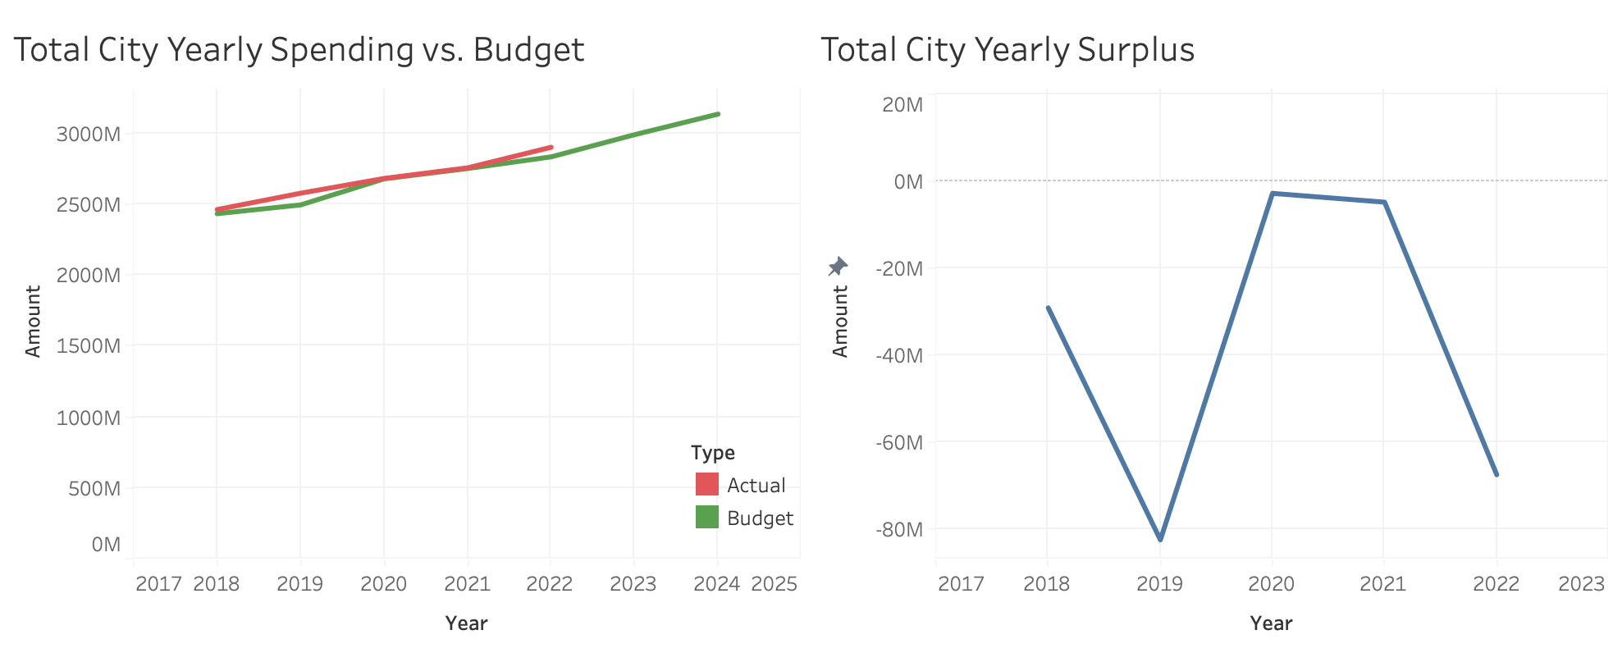
Overall City Spending vs. Budget
The City of Boston has a negative surplus (difference between actual spending and allocated budget) of -$37M on average between 2018 and 2022 (except during COVID-19 when the deficit was closer to 0).

Slide 7
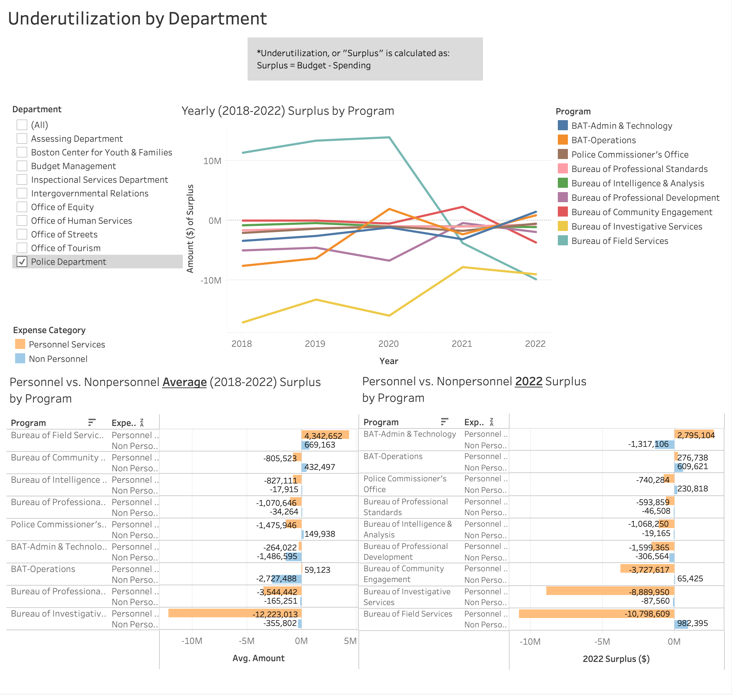
Boston Police Department
Underutilization Analysis
Total Surplus in 2022: -$24M
Personnel Surplus: -$24M
Non Personnel Surplus: +$111K
Top programs with surplus in 2022:
BAT Admin & Technology: $1.5M
BAT Operations: $886K

Slide 8
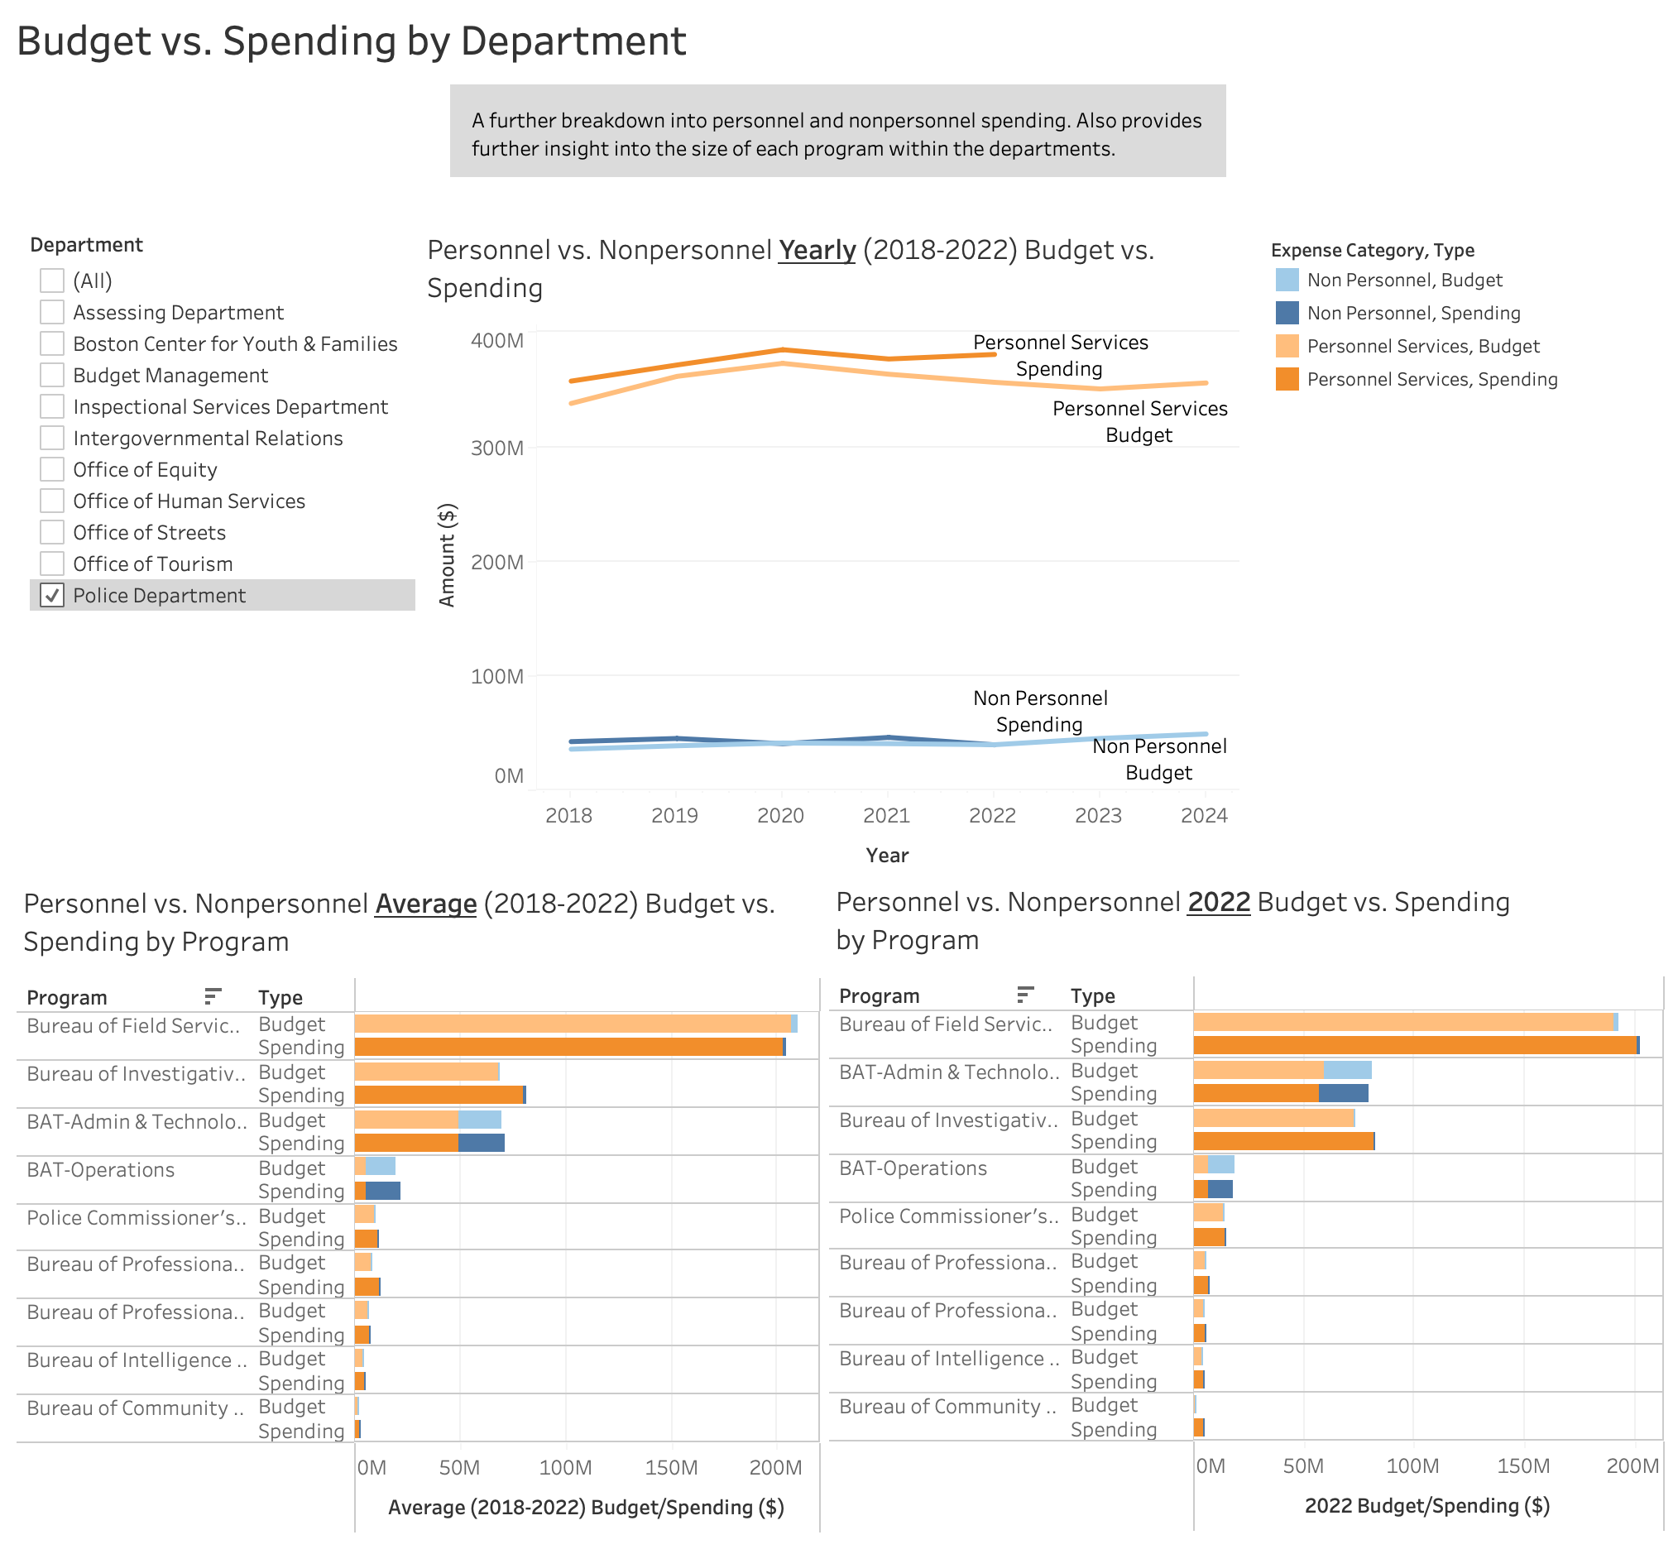
Boston Police Department
Budget vs. Spending Analysis
Personnel spending is significantly higher than non personnel.
Spending is higher than the budget for both categories.
The Bureau of Field Services program has the highest spending at around $200M on average, followed by Bureau of Investigative services and BAT Admin & Technology at around $70M.
BAT Admin & Technology and BAT Operations have a higher proportion of Non Personnel spending than other programs.

Slide 9
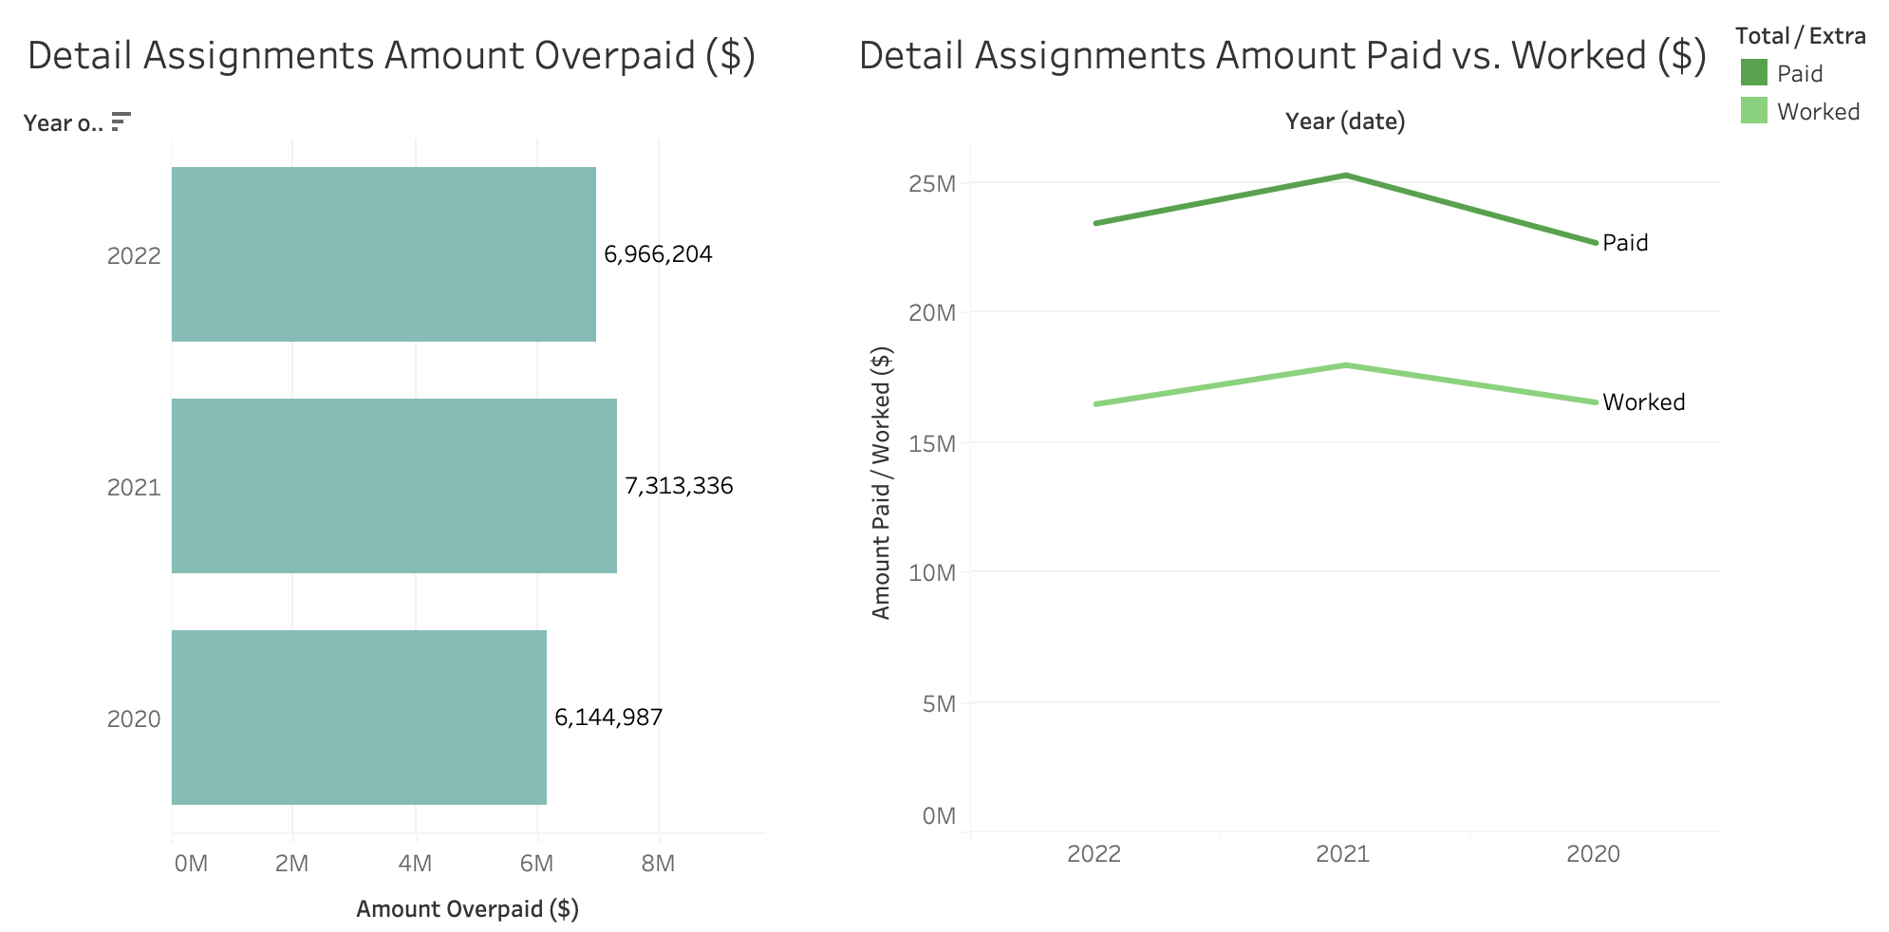
Boston Police Department
Overtime Pay Analysis
For detail assignments, on average there is around $6M being overpaid (for hours not worked) between 2020 and 2022.
In 2022, the most recent year available, there is around $7M overpaid for detail assignments.
In 2022, around 27% of total payment for detail assignments was paid for hours not worked.
BPD Overtime Policy:
0-4 hours worked are paid for 4 hours
4-8 hours worked are paid for 8 hours

Slide 10
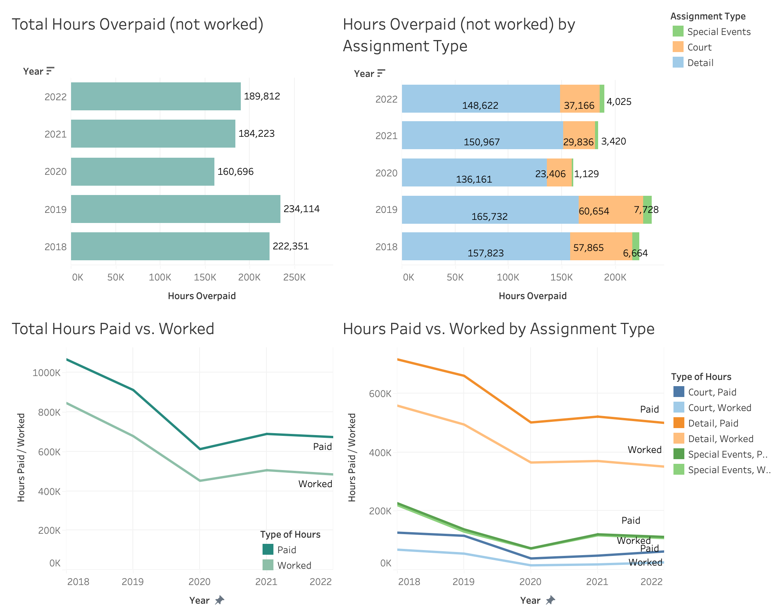
Boston Police Department
Overtime Hours Analysis
For detail and court assignments, there were around 190K total overpaid hours (hours not worked) in 2022.
For detail assignments, there were around 149K overpaid hours in 2022.
For court assignments, there were around 37K overpaid hours in 2022.
For special events assignments, there were around 4K overpaid hours in 2022.
BPD Overtime Policy:
0-4 hours worked are paid for 4 hours
4-8 hours worked are paid for 8 hours

Slide 11
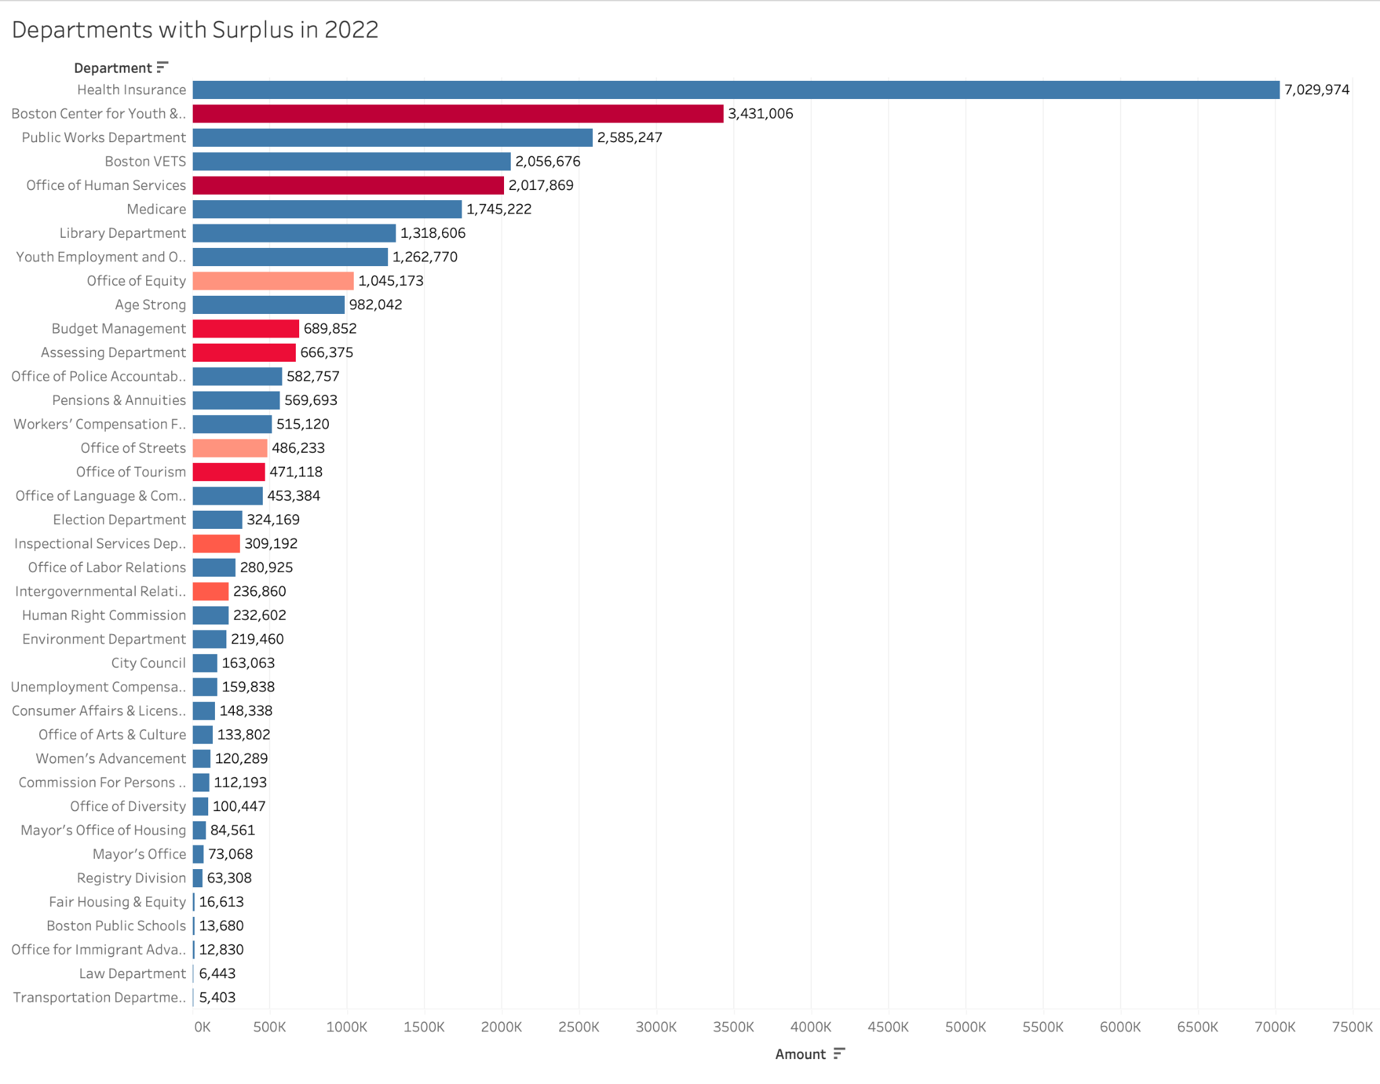

Selecting Departments of Feasibility
Feasibility Rankings Departments with Positive Surplus in 2022
? | **Center for Youth & Families **Office of Human Services Medicare Payments
9 | **Budget Management **Assessing Department **Office of Tourism Registry
8 | Mayor’s Office
7 | **Intergovernmental Relations Consumer Affairs
6 | **ISD (5/6)
5 | **Office of Equity
4 | **Office of Streets
3 | Age Strong, Election Dept, Women’s Advancement, Public Works
2 | Library Dept, Office of Police Accountability, Office of Language, Office of Arts & Culture, Human Rights Commission, BCYF
1 | Environment, City Council, Commission for Persons with Disability, Mayor’s Office of Housing, Youth Employment & Opportunity, Office of Labor Relations
0 | Pensions & Annuities, Workers Comp, Health Insurance, Boston VETS
These top 10 departments of interest were identified by selecting the departments with the highest feasibility rankings and most surplus in 2022.
0 9
Budget Transfer Feasibility

Slide 12
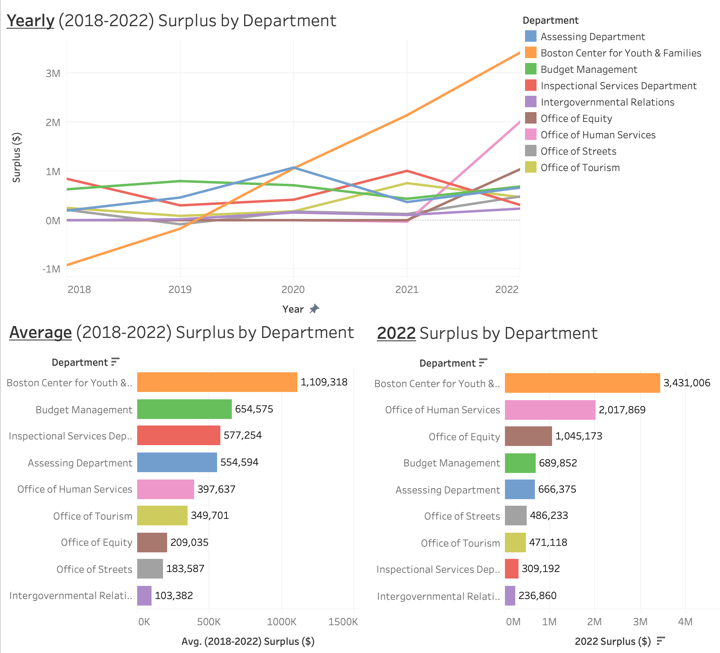
Underutilization in Top Departments
Total 2022 Surplus in Top Departments: $9.4M
Charts for each department, departments ordered by 2022 surplus.
Underutilization analysis
Yearly (2018-2022) Surplus by Program
Personnel vs. Non Personnel Average (2018-2022) Surplus by Program
Personnel vs. Non Personnel 2022 Surplus by Program
Budget vs. Spending analysis
Personnel vs. Non Personnel Yearly (2018-2022) Budget vs. Spending by Program
Personnel vs. Non Personnel Average (2018-2022) Budget vs. Spending by Program
Personnel vs. Non Personnel 2022 Budget vs. Spending by Program

Slide 13
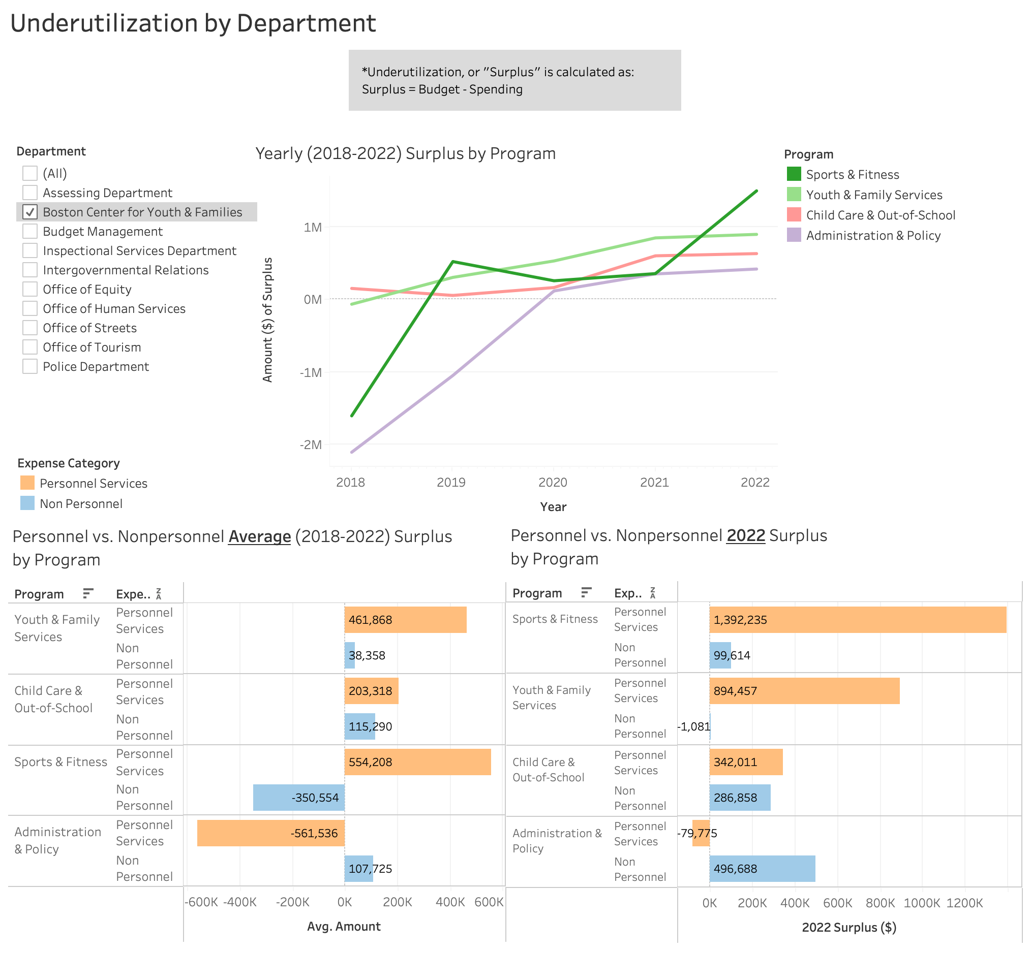
1a. Boston Center for Youth & Families
Underutilization Analysis
Total Surplus in 2022: $3.4M
Personnel Surplus: $2.5M
Non Personnel Surplus: $882K
Top programs with surplus in 2022:
Sports & Fitness: $1.5M
Youth & Family Services: $893K

Slide 14
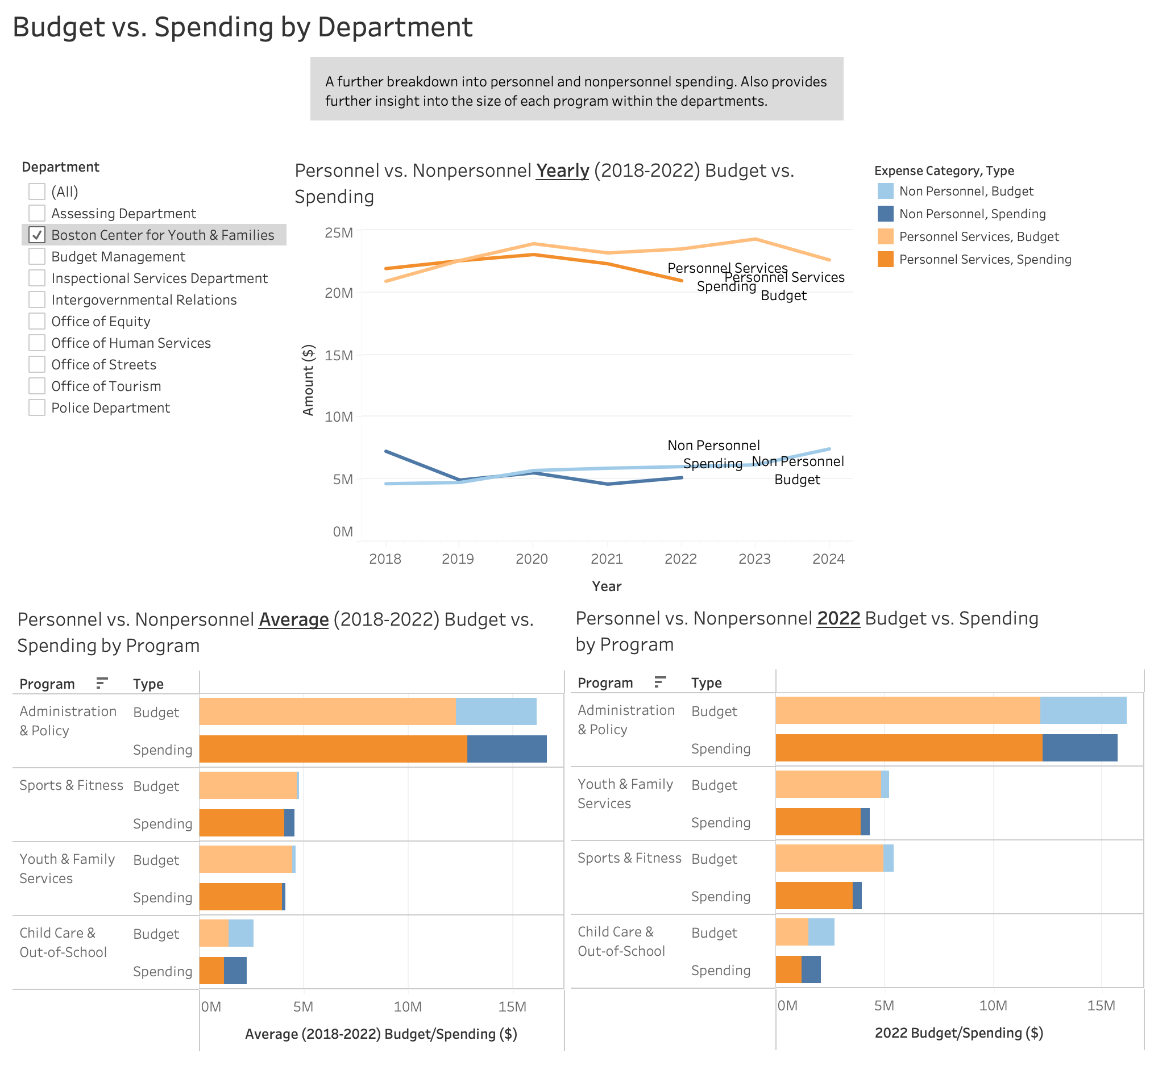
1b. Boston Center for Youth & Families
Budget vs. Spending Analysis
Personnel spending is significantly higher than non personnel.
Spending is less than budget for both categories in 2022.
The Administration & Policy program has the highest spending at around $16.6M on average and around $15.7M in 2022.
The Administration & Policy program also has the highest proportion of non personnel spending as compared to other programs in this department.

Slide 15
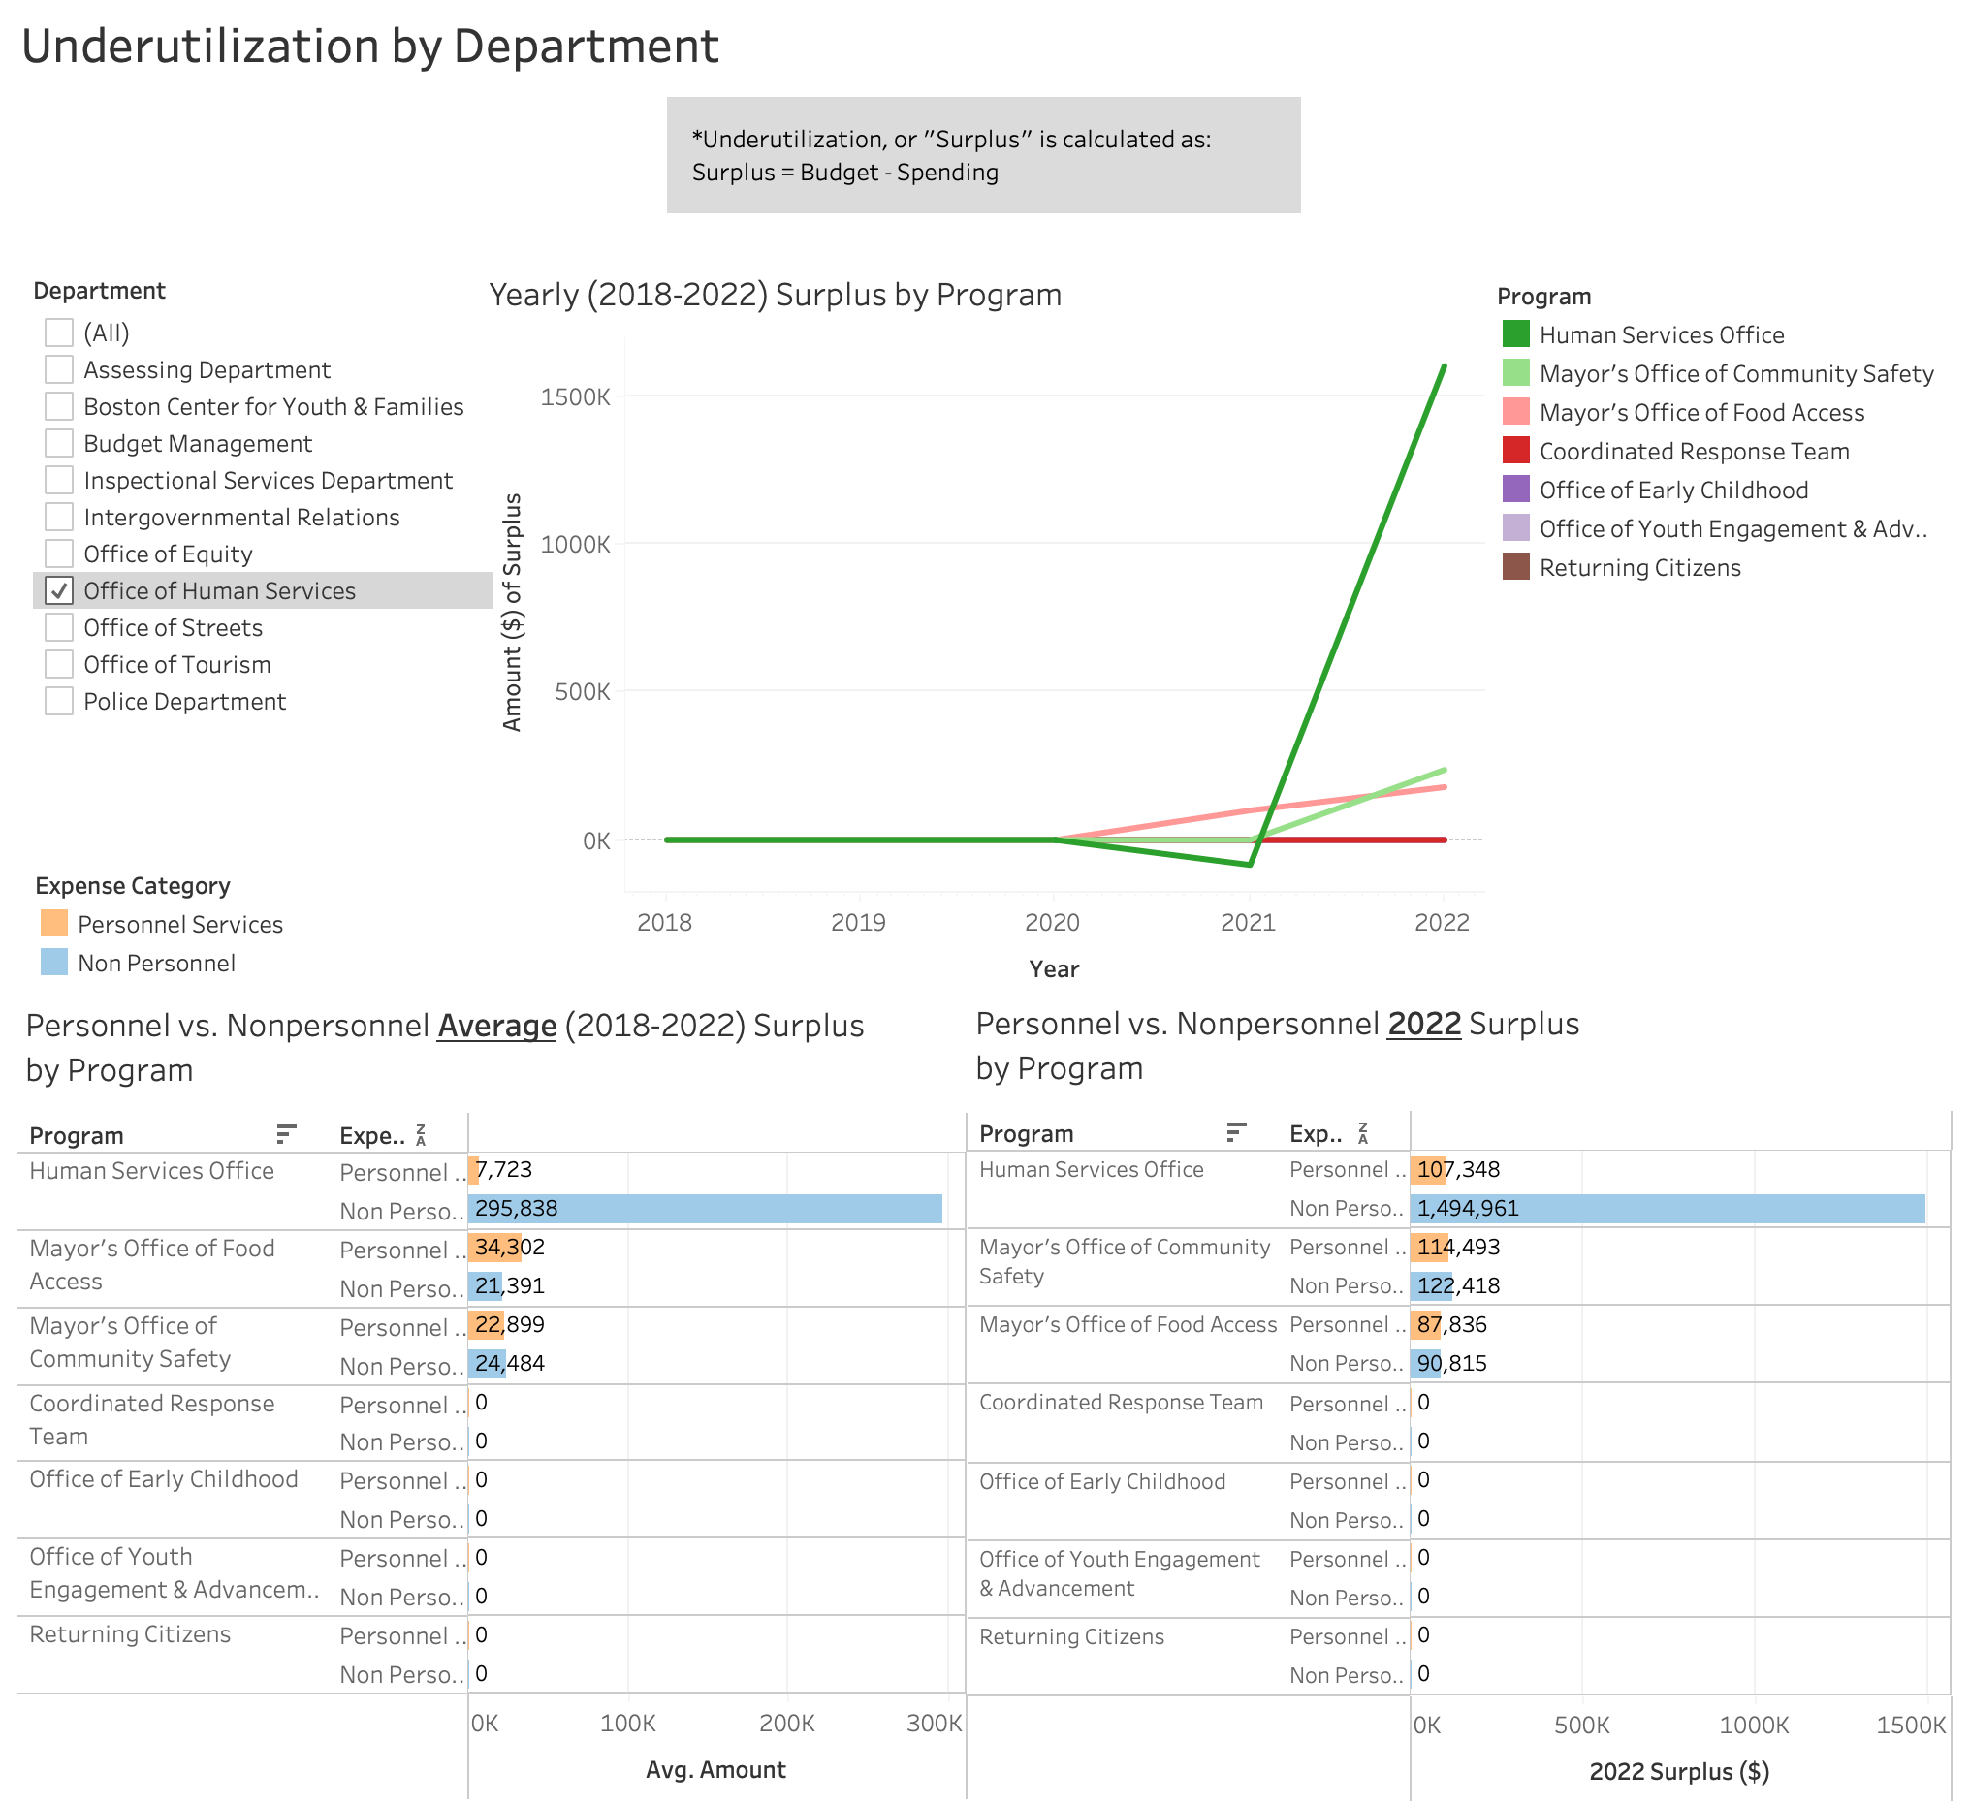
2a. Office of Human Services
Underutilization Analysis
Total Surplus in 2022: $2M
Personnel Surplus: $310K
Non Personnel Surplus: $1.7M
Top programs with surplus in 2022:
Human Services Office: $1.6M

Slide 16
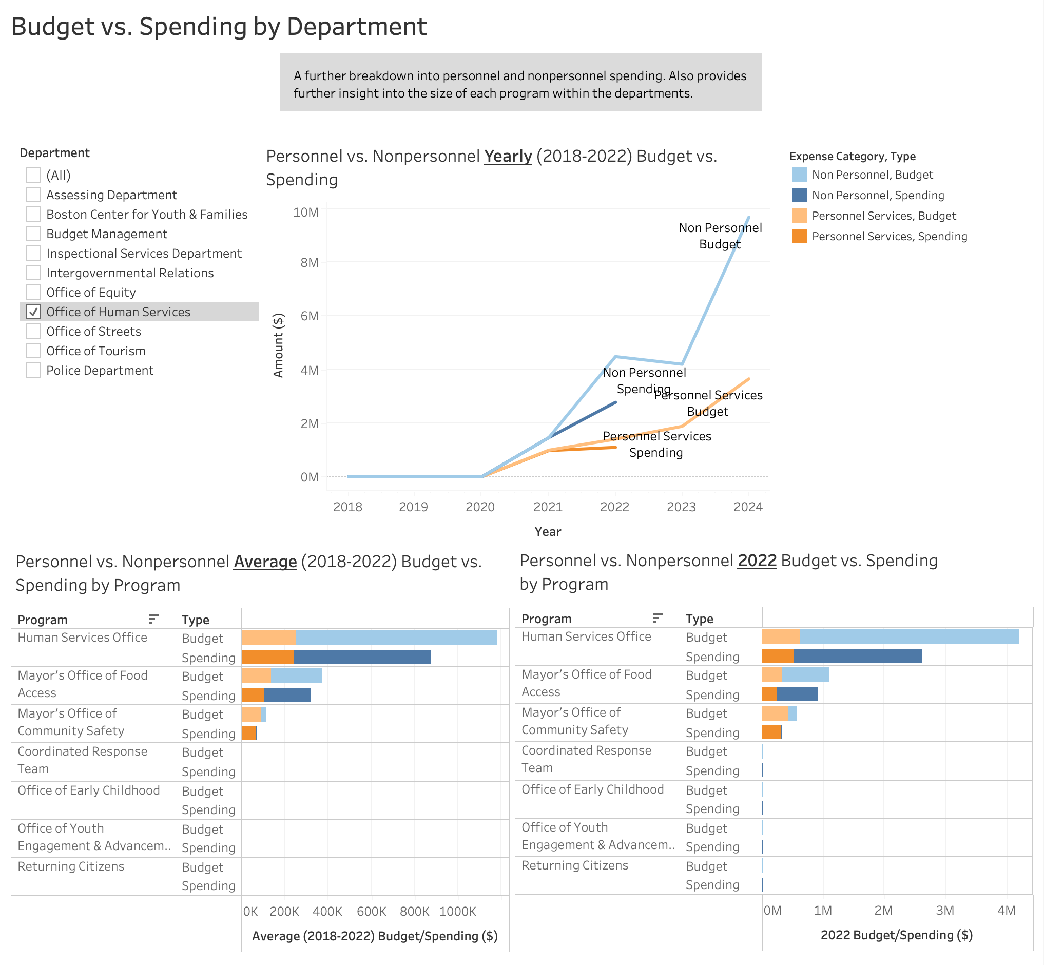
2b. Office of Human Services
Budget vs. Spending Analysis
Non personnel spending is higher than personnel spending.
Spending is less than the budget for both categories in 2022.
The Human Services Office program has the highest spending at around $875K on average and $2.6M in 2022.
The Human Services Office program and the Mayor’s Office of Food Access program both have a higher proportion of non personnel spending as compared to the Mayor’s Office of Community Safety.

Slide 17
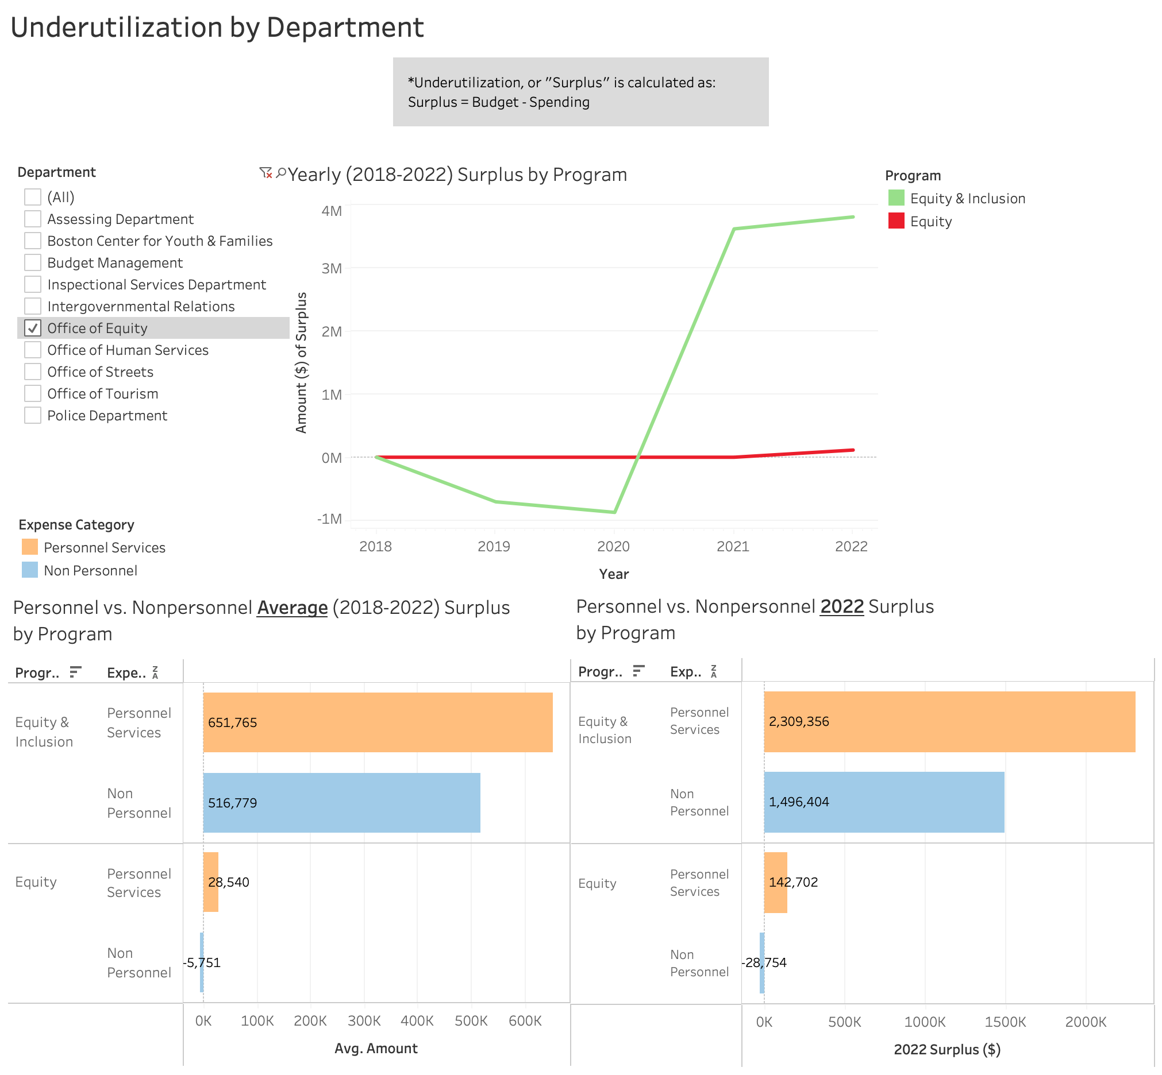
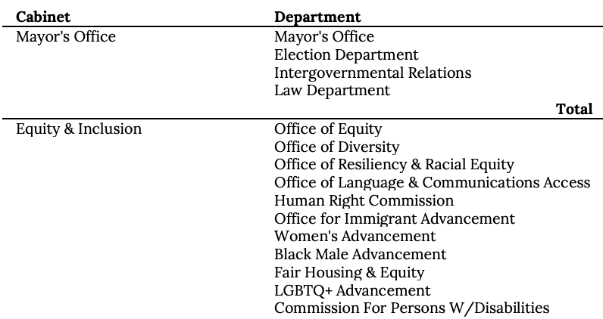
3a. Office of Equity
Underutilization Analysis
Total Surplus in 2022: $1.05M
The Equity and Inclusion program in the Office of Equity department budgeted $3.8M in 2022 but had $0 documented spending.
However, $2.8M out of the $4.3M was spent in 2022 on the Supplier Diversity program in the Office of Equity department. The Supplier Diversity program does not appear in the chart because it did not have any documented budget breakdown data of personnel vs. non personnel expense categories in the budget pdf.
The Equity and Inclusion program funds were possibly redistributed to the Supplier Diversity program in the Office of Equity department, or to other departments that were newly introduced to the Equity & Inclusion cabinet in 2022, as shown below:

Slide 18
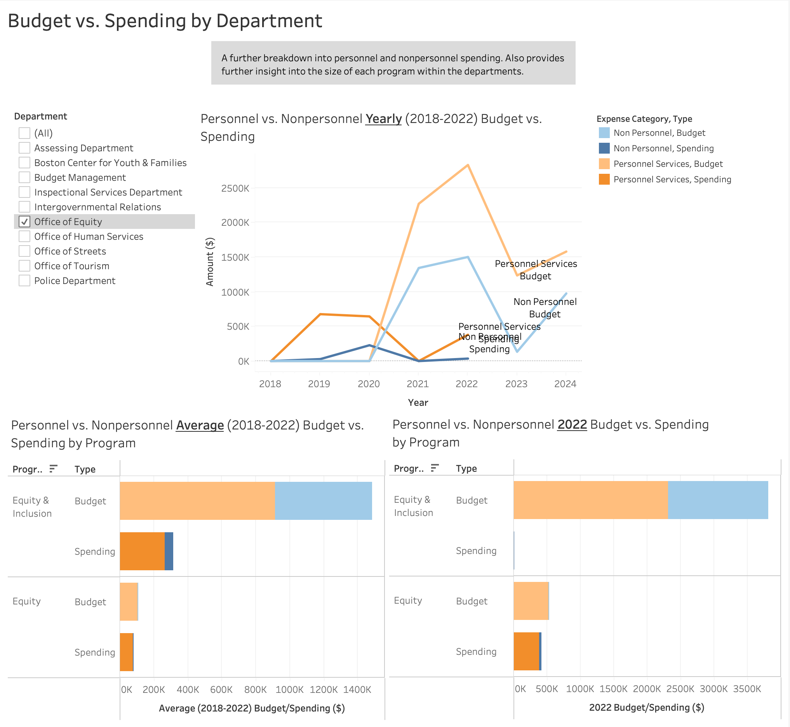
3b. Office of Equity
Budget vs. Spending Analysis
Personnel spending is higher than Non-personnel spending.
Spending is less than the budget for both categories.
$2.8M out of the $4.3M was spent in 2022 on the Supplier Diversity program in the Office of Equity department. The Supplier Diversity program does not appear in the chart because it did not have any documented budget breakdown data of personnel vs. non personnel expense categories in the budget pdf.
The Equity and Inclusion program funds were possibly redistributed to the Supplier Diversity program in the Office of Equity department, or to other departments that were newly introduced to the Equity & Inclusion cabinet in 2022, as shown below:

Slide 19
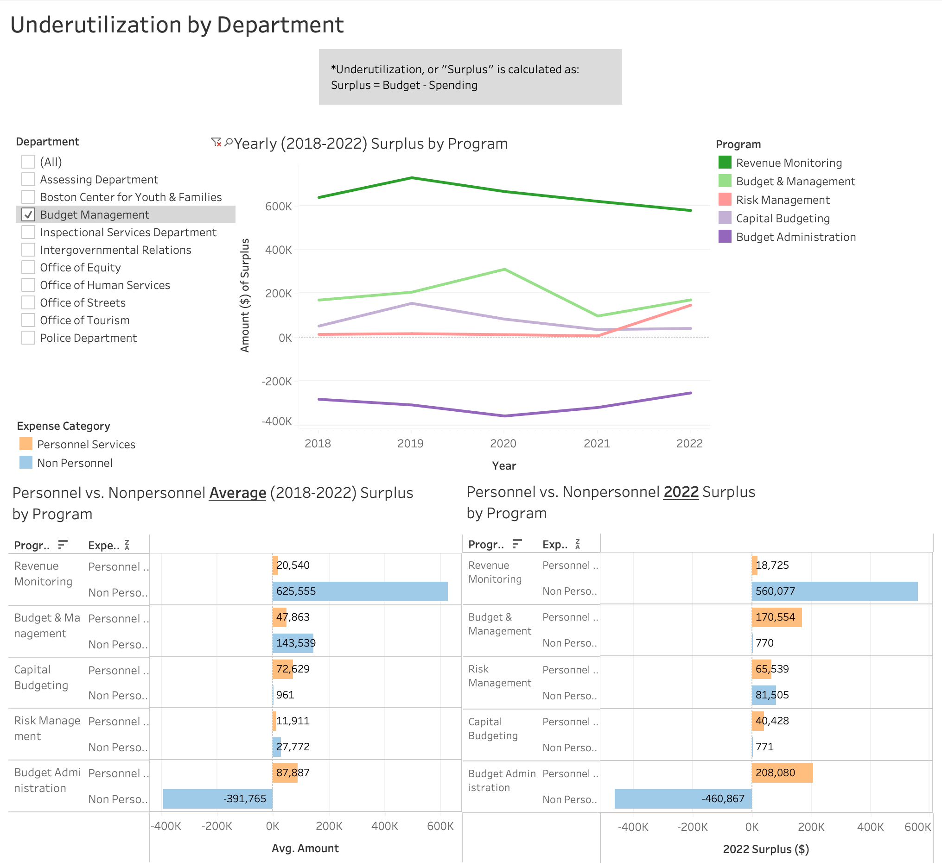
4a. Budget Management
Underutilization Analysis
Total Surplus in 2022: $690K
Personnel Surplus: $503K
Non Personnel Surplus: $182K
Top programs with surplus in 2022:
Revenue Monitoring: $579K

Slide 20
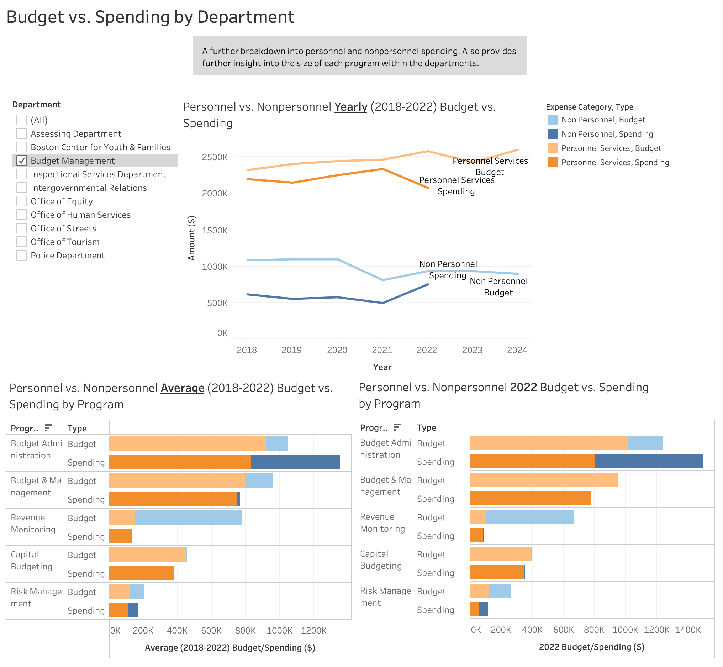
4b. Budget Management
Budget vs. Spending Analysis
Personnel spending is significantly higher than Non personnel spending.
Spending is less than the budget for both categories.
The Budget Administration program has the highest spending at around $1.3M on average and $1.5M in 2022.
The Budget & Management program and Risk Management program have a higher proportion of non personnel spending as compared to other programs in this department.

Slide 21
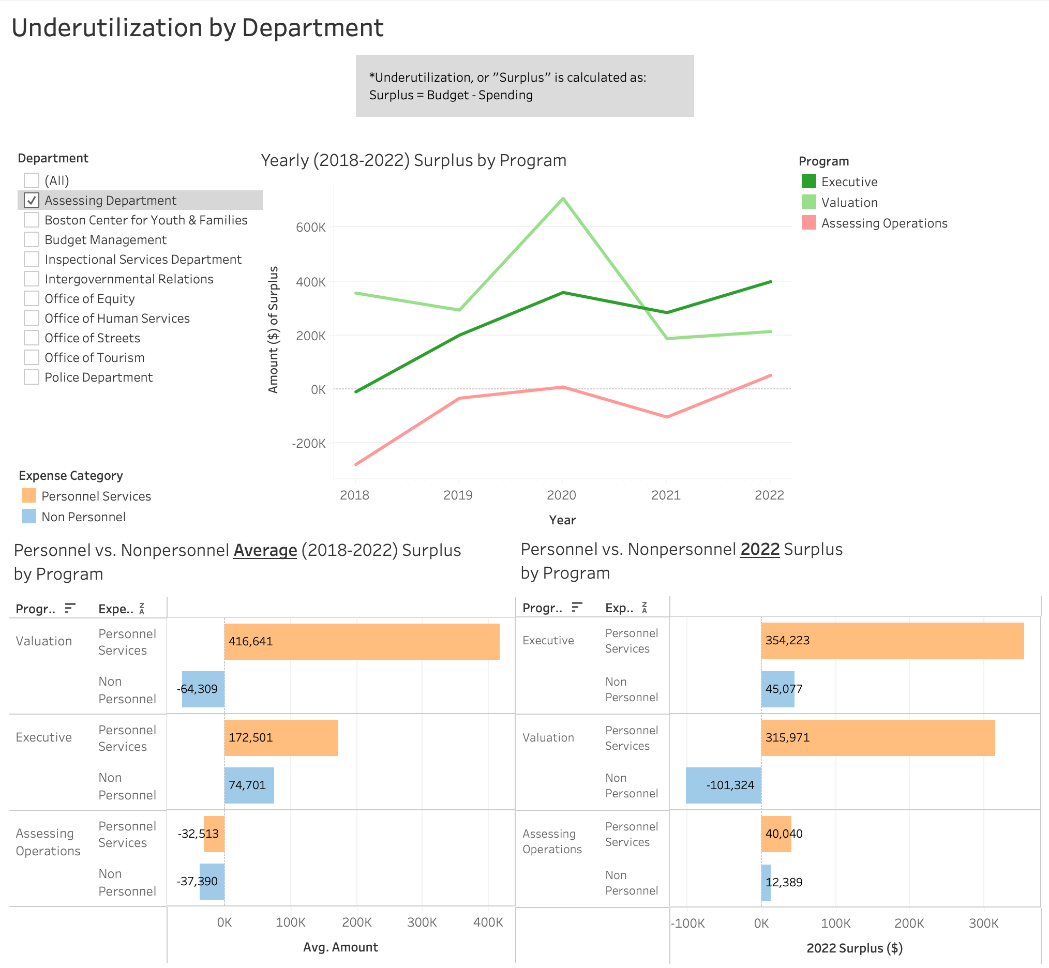
5a. Assessing Department
Underutilization Analysis
Total Surplus in 2022: $667K
Personnel Surplus: $710K
Non Personnel Surplus: -$44K
Top programs with surplus in 2022:
Executive: $399K
Valuation: $215K

Slide 22
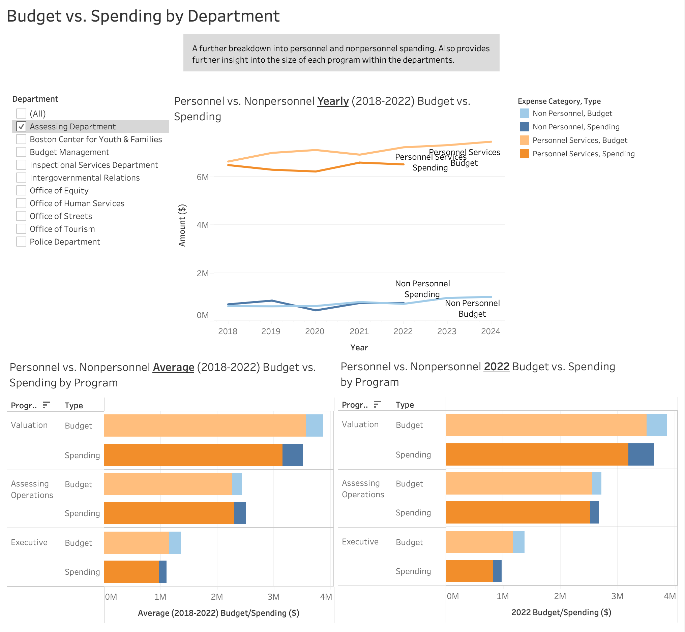
5b. Assessing Department
Budget vs. Spending Analysis
Personnel spending is significantly higher than Non personnel spending in all programs within this department.
Spending is less than the budget for Personnel and fluctuates for Non personnel.
The Valuation program has the highest spending at around $3.5M on average and $3.6M in 2022.

Slide 23
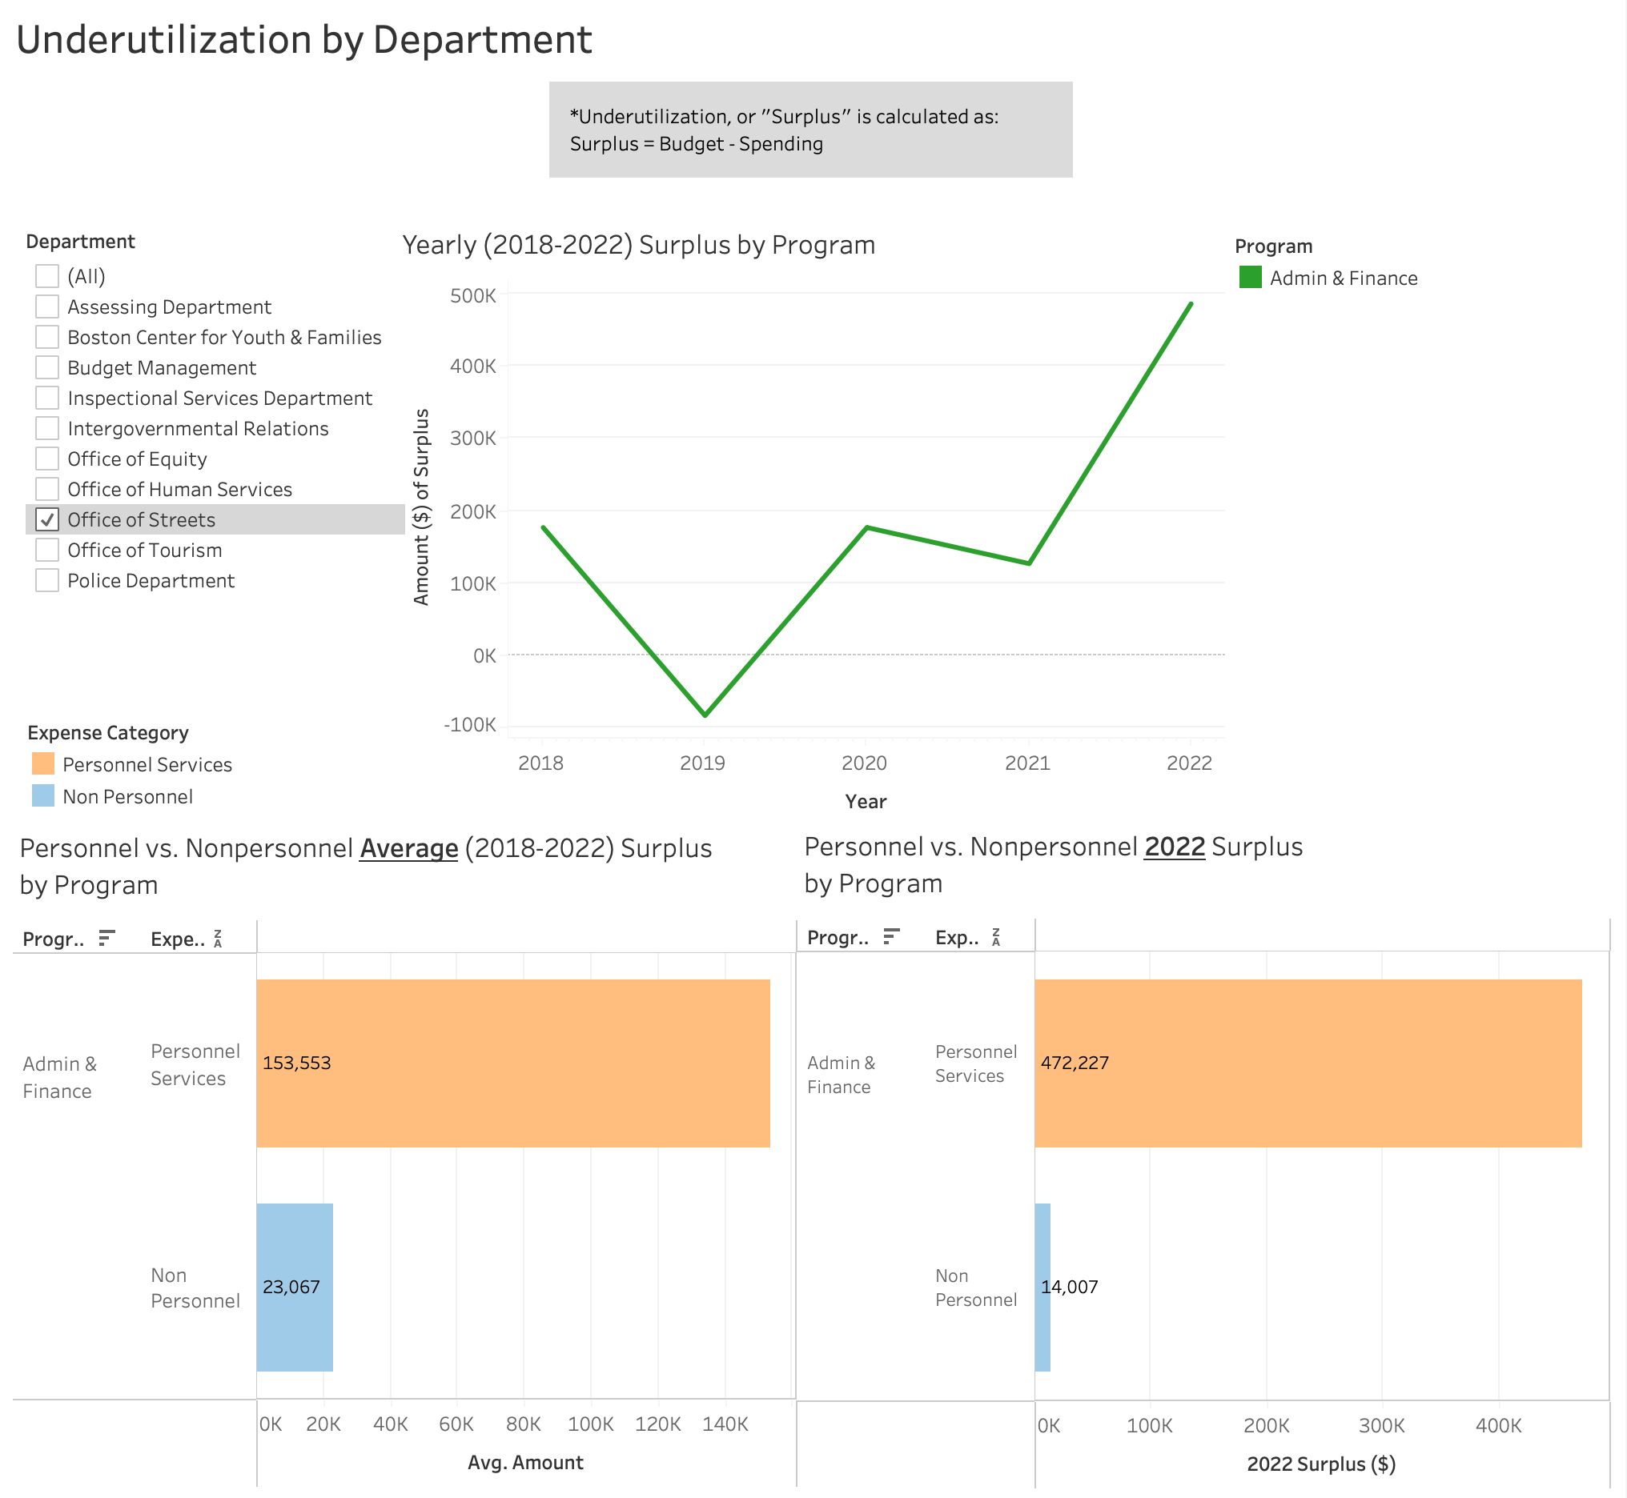
6a. Office of Streets
Underutilization Analysis
Total Surplus in 2022: $486K
Personnel Surplus: $472K
Non Personnel Surplus: $14K
Notes:
Top left graph: big gap of the two lines. Instead of having 4 lines can do 2 lines and it just be the differences, not all individually.
Need to have consistent colors, too many colors.

Slide 24
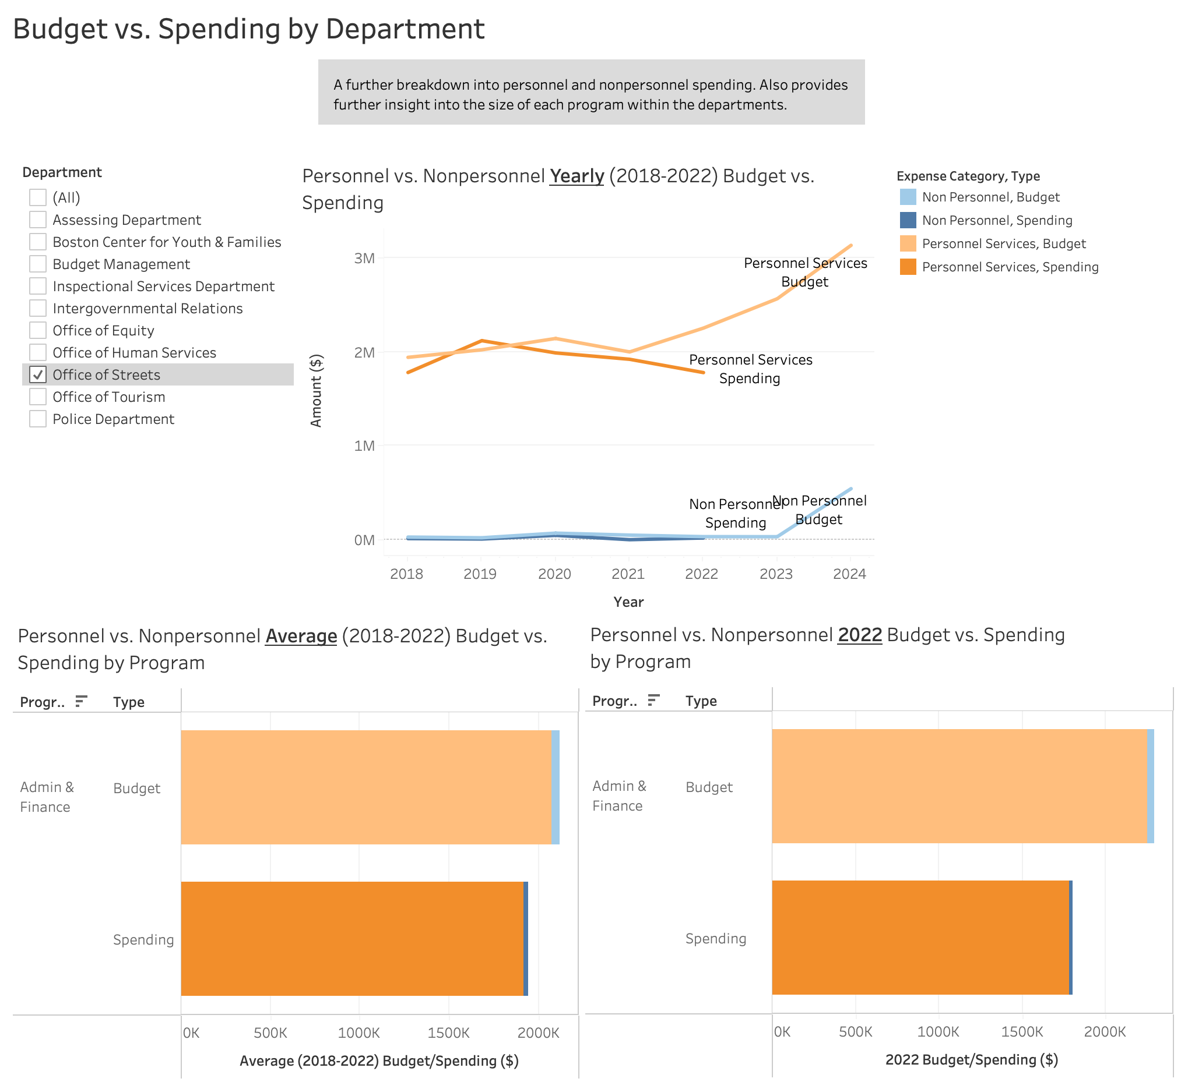
6b. Office of Streets
Budget vs. Spending Analysis
Personnel spending is significantly higher than Non personnel spending.
Spending is less than the budget for both categories.
The Office of Streets department spent around $1.94M on average and around $1.8M in 2022.
Notes:
Top left graph: big gap of the two lines. Instead of having 4 lines can do 2 lines and it just be the differences, not all individually.
Need to have consistent colors, too many colors.

Slide 25
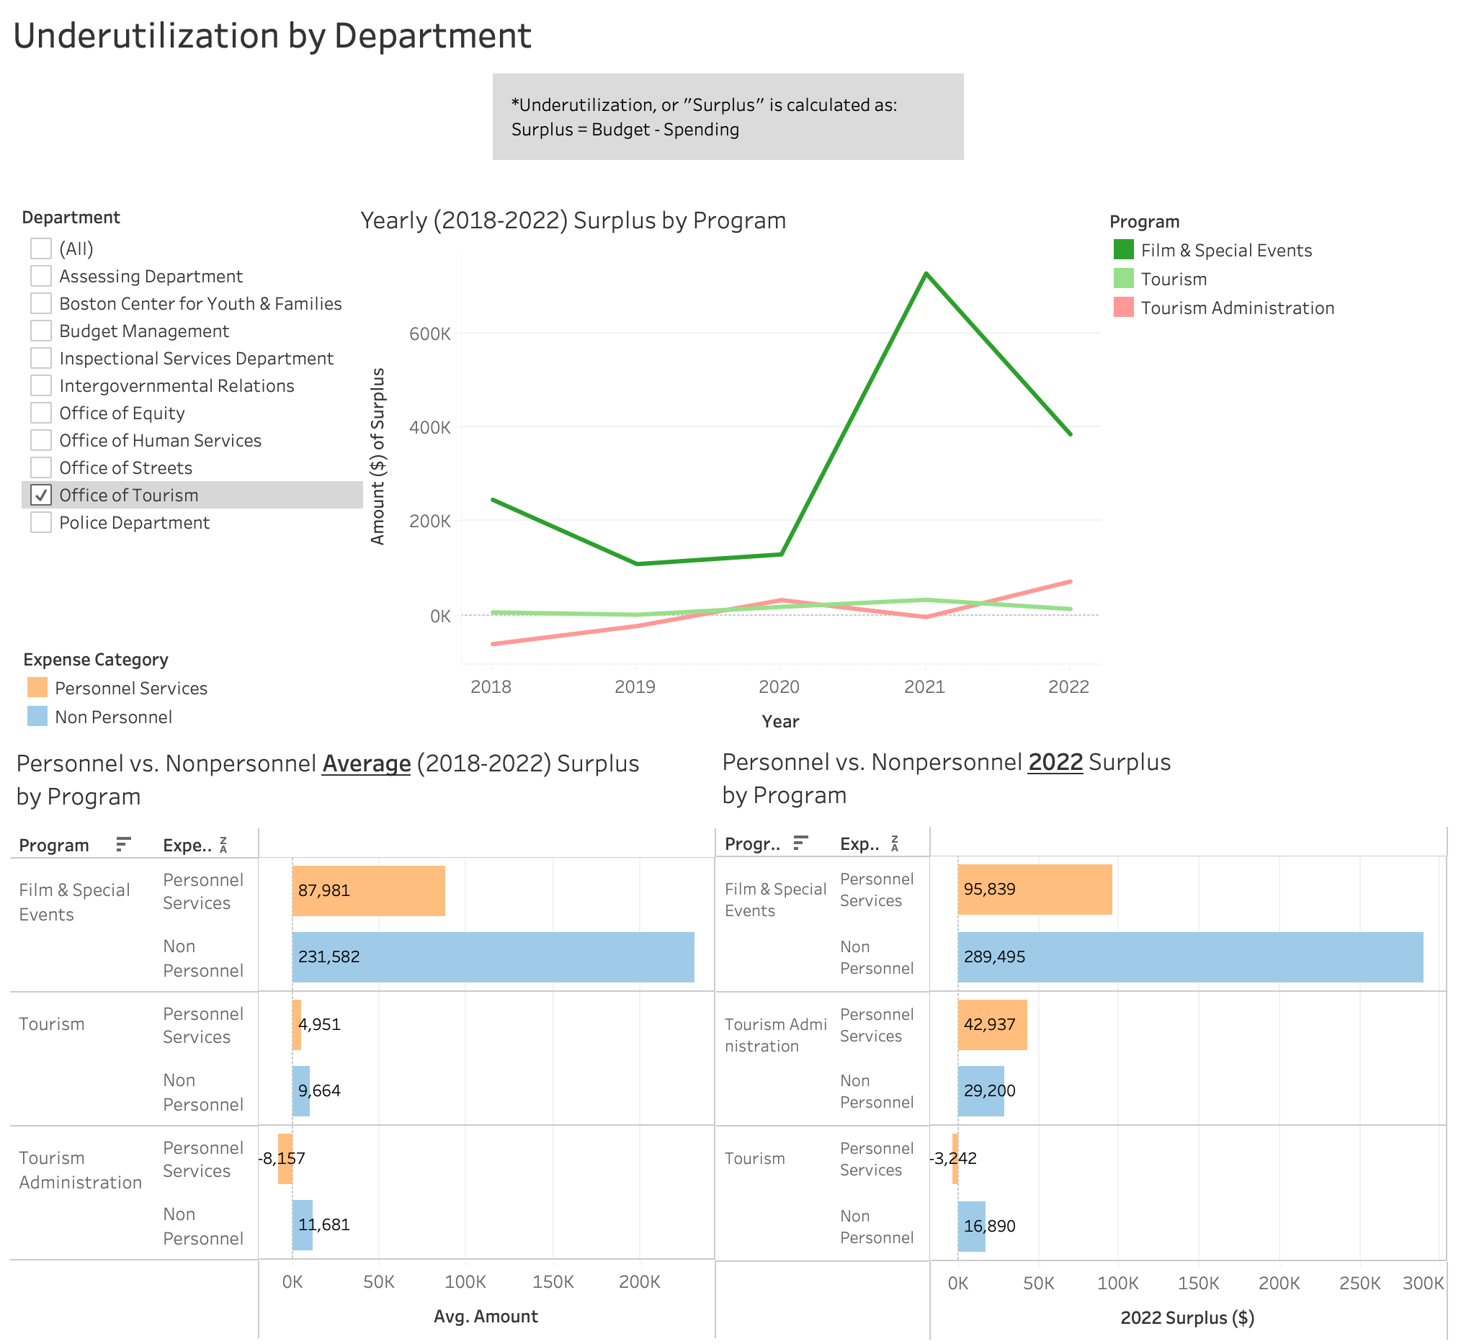
7a. Office of Tourism
Underutilization Analysis
Total Surplus in 2022: $471K
Personnel Surplus: $136K
Non Personnel Surplus: $336K
Top programs with surplus in 2022:
Film & Special Events: $385K

Slide 26
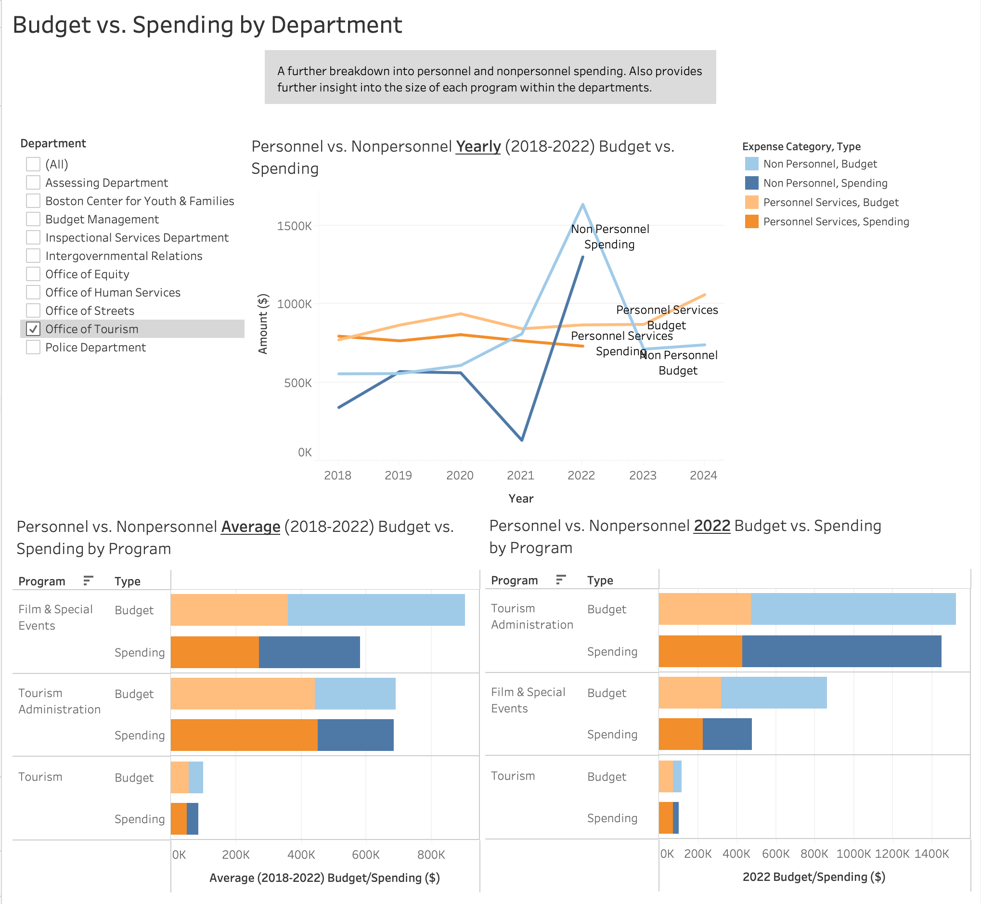
7b. Office of Tourism
Budget vs. Spending Analysis
Personnel spending is typically higher than Non personnel spending, except in 2022.
Spending is less than the budget for both categories.
The Tourism Administration program has the highest spending at around $582K on average and $1.45M in 2022.
The Tourism Administration program and Film & Special Events program have a higher proportion of non personnel spending as compared to the Tourism program.

Slide 27
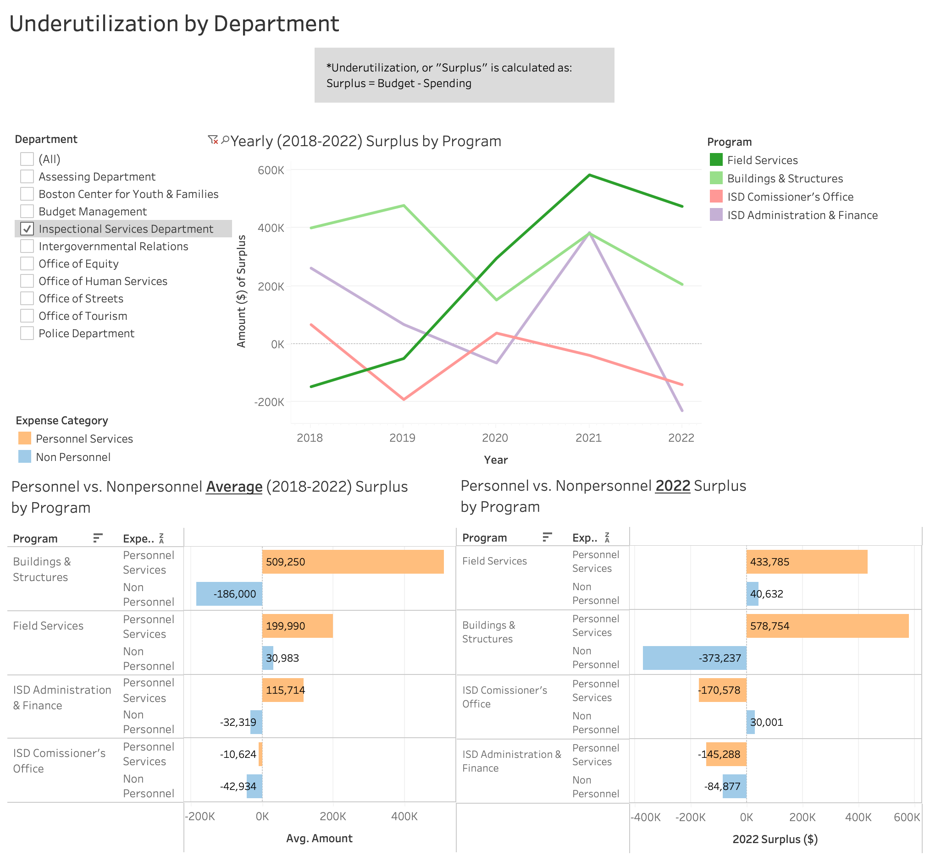
8a. Inspectional Services Department
Underutilization Analysis
Total Surplus in 2022: $309K
Personnel Surplus: $697K
Non Personnel Surplus: -$387K
Top programs with surplus in 2022:
Field Services: $474K
Buildings & Structures: $206K

Slide 28
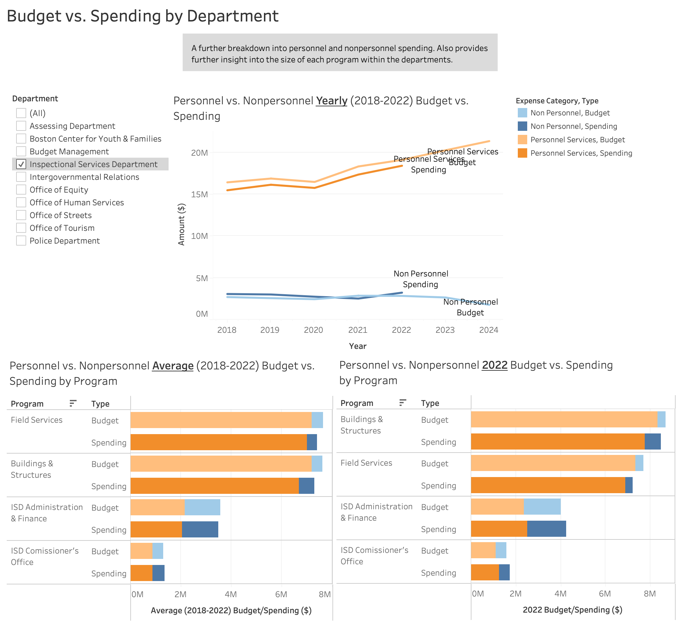
8b. Inspectional Services Department
Budget vs. Spending Analysis
Personnel spending is significantly higher than Non personnel spending.
Spending is less than the budget for both categories, except Non personnel in 2022.
The Building & Structures program has the highest spending at around $8.5M in 2022.
The ISD Administration and Finance program has a higher proportion of non personnel spending as compared to other programs within this department

Slide 29
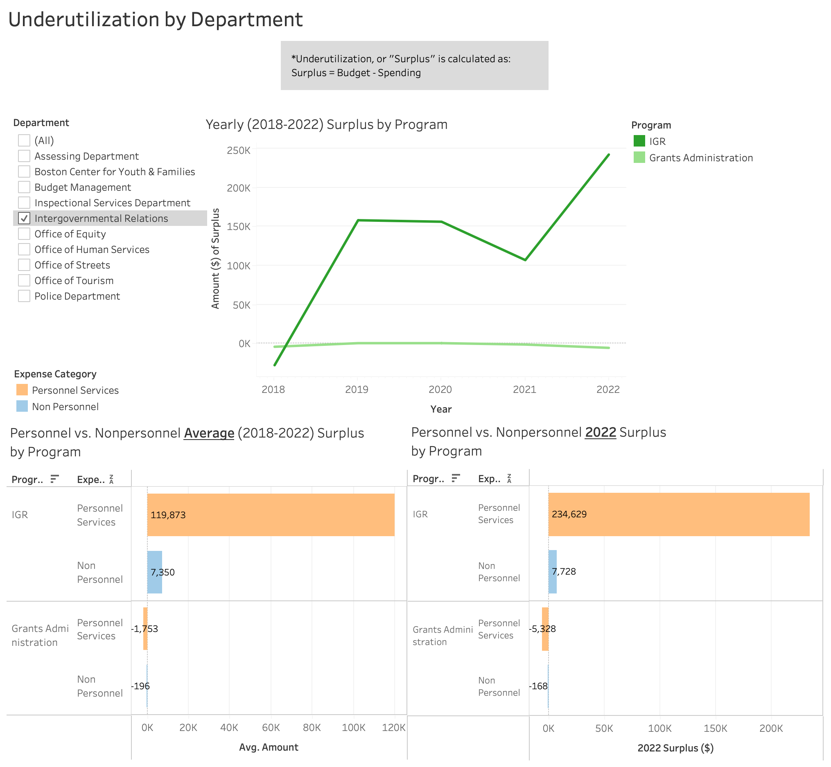
9a. Intergovernmental Relations
Underutilization Analysis
Total Surplus in 2022: $237K
Personnel Surplus: $229K
Non Personnel Surplus: $7.5K
Top programs with surplus in 2022:
Intergovernmental Relations: $242K

Slide 30
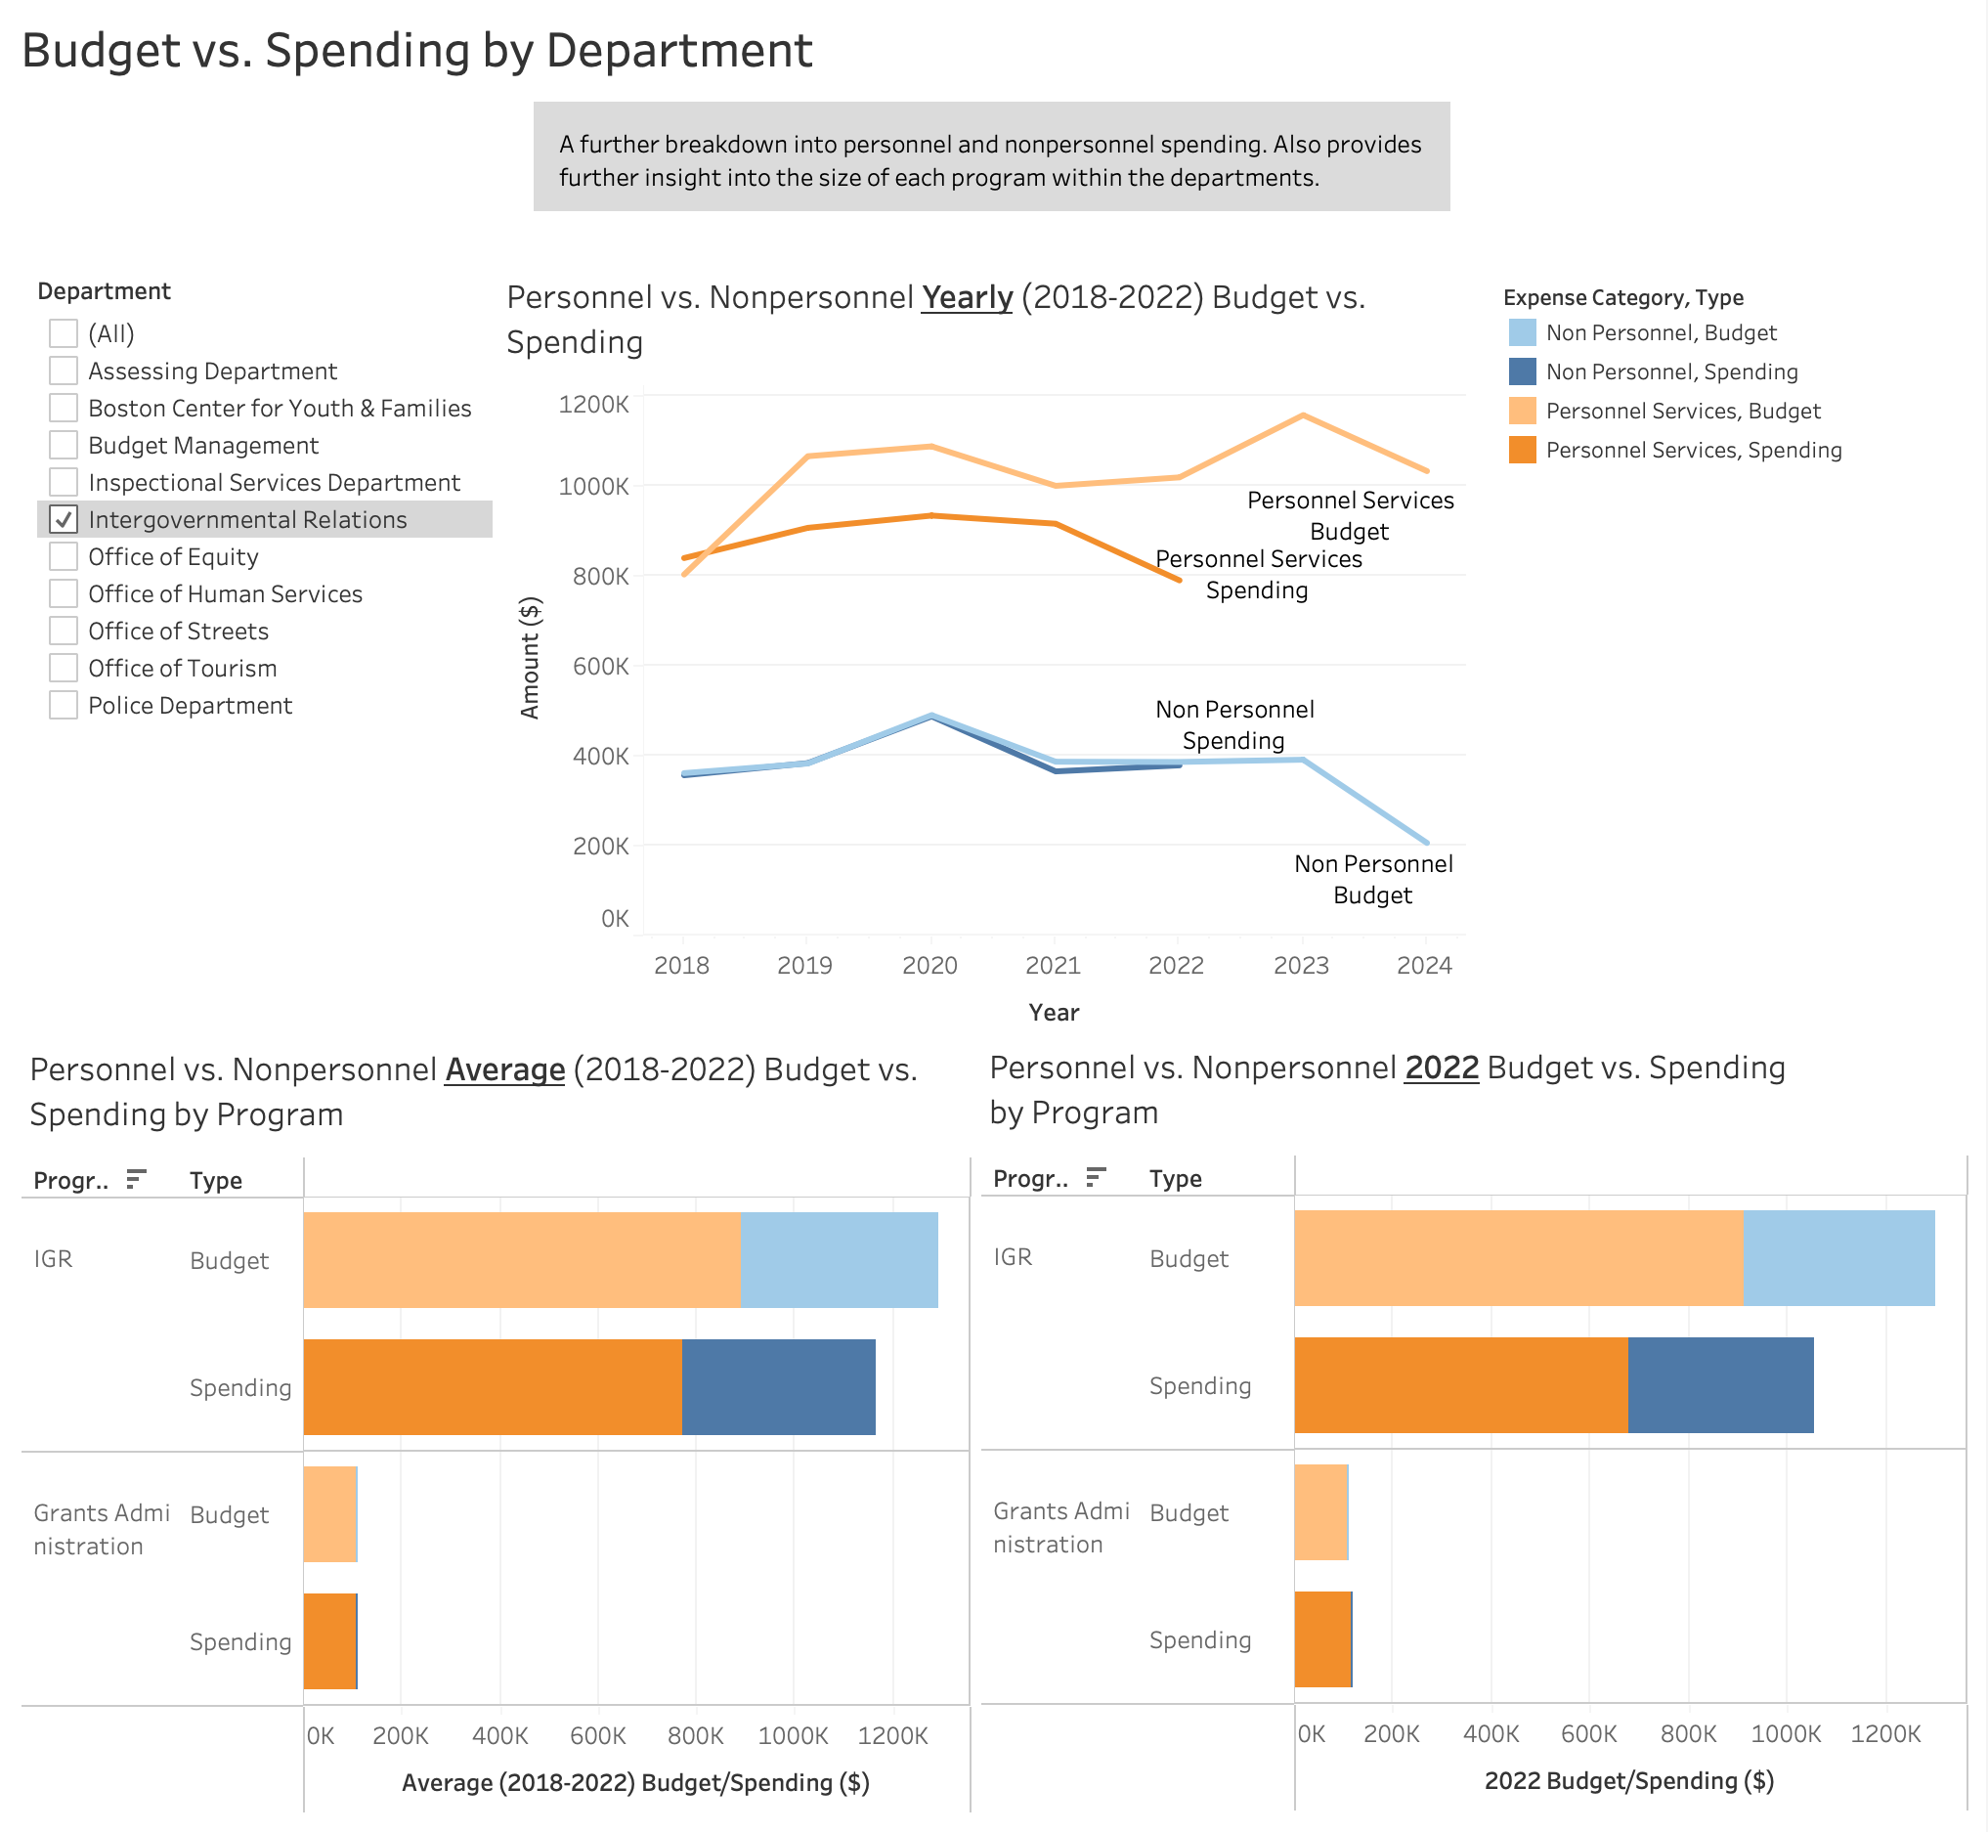
9b. Intergovernmental Relations
Budget vs. Spending Analysis
Personnel spending is significantly higher than Non personnel spending.
Spending is less than the budget for both categories.
The IGR program has the highest spending at around $1.16M on average and $1.06 in 2022.
The IGR program has a higher proportion of non personnel spending than the Grants Administration program.

Slide 31
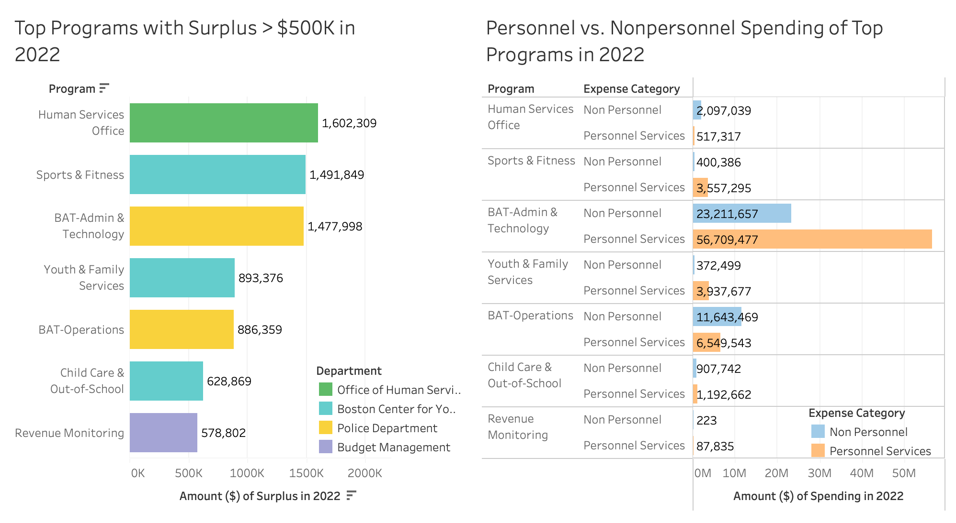
Breakdown of Top Programs
This focuses on the top individual programs’ within the departments with surplus and spending side by side, highlighting personnel spending.
Total surplus from these programs is around $7,6M.
If personnel spending could be reduced by utilizing civilian flaggers instead of paying overtime, this may result in increased surplus.

Slide 32
Key Takeaways
Personnel spending is significantly higher than Non Personnel spending in almost all of these selected departments of interest, except Office of Human Services.
There was at least $7M overpaid to Boston Police Department officers for hours not worked in 2022 (only counting detail assignments).
Top programs of interest are Human Services Office, Sports and Fitness, BAT Admin & Technology, with over $1M surplus in 2022, and Youth & Family Services, BAT Operations, Child Care & Out-of-School, and Revenue Monitoring with over $500K surplus in 2022.

Slide 33
Limitations and Next Steps
Limitations:
Calculating overtime hours and pay shows what is can suggest changes but there's no guarantee that identifying this amount overpaid will change next year
Department budgets change and fluctuate each year
Data entry
Next Steps:
Further breakdown of program expense categories (Personnel Services, Contractual Services, Supplies & Materials, Current Charges & Obligations, and Equipment)
Overtime pay details for 2018-2019 to get trends from the full five year picture to compare with the rest of the budget analysis.
Include numbers from 2023 for more recent data, as well as a detailed breakdown of the Public Works department.

Slide 34
Thank you!
Q & A

